Slide 1
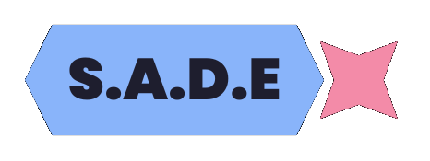
S.A.D.E
Smart Assistive Device for the Elderly
By Taida Chinamo

Slide 2
Problem

Slide 3
Problem Introduction
39% of elderly citizens (who are 65+ in age) , in rural communities in Zimbabwe, face a daily struggle with technology. The digital divide isn't just a matter of smartphones and social media; it's about accessing basic necessities like government or banking services, health information sevices and online shopping.
For many rural elders, physical limitations like arthritis, hearing loss or vision loss render traditional devices unusable. The internet may often be unavailable, unreliable or expensive in their areas. This digital isolation can lead to a cascade of problems: dependence on others for everyday tasks like: news and local updates or learning new skills, a decline in autonomy ( the capacity for self-governance), and even social isolation from friends and family.
From Pew Research Center

Slide 4
Problem Statement
For rural elders, existing tech can be a complicated. Designed for more experienced individuals (like younger people, engineers and programmers), these interfaces overwhelm rural elders with options (like settings and complicated prompts), leaving them frustrated and discouraged from using technology regularly.
SADE provides rural elders with the tools they need like an uncomplicated intuitive user interface, a voice assistant, an easy to use app and a smart, accessible device with a touch screen to perform essential everyday tasks like contacting friends and family or booking health appointments.

Slide 5
Design

Slide 6
Design Brief
Application
The SADE application will be made using the Rust programming language with Qt’s (a widely used GUI framework mostly for Linux that has bindings for most major languages) rust bindings which makes the application very fast to run and use for the user.
Voice Assistant
The SADE voice assistant will be made using the Rust programming language and is referred to as Sade.
The voice assistant is split into 4 different parts:
Speech To Text
Wake Word Detection
A Chat-bot
Text To Speech
Device
The SADE device will only cost $250 to do a one-off manufacture.
It will run a highly modified version of Linux with modified KDE

Slide 7
Can be reused
4GB of RAM
Portable
Uses recycled materials
To Manufacture
4 Cores
To Sell
Specifications
Can be used as a tablet
Linux
Microphone and Speaker
Price
Operating System
Sustainability
Device
AI Models
Rural
Elders
Customizablility
Smart Assistive
Device for the
Elderly (S.A.D.E)
Rust
Audience
Voice
Assistant
Programming Language
MIT License
Programming Language
Application
Open-Source
GUI Framework
Features
Hosted on Github
Calendar
Python
Chat-bot
QT
Reminder

Slide 8
Product Specification - SADE
Target Market : The target market are rural female elders, who have to depend on someone else for their daily needs.
Functions : The device will be small, handheld and portable with a large base to allow it to be placed upright on a table. The voice assistant will run locally without the need for internet. The application will be made using rust and will have a simple user interface to allow people to access its calendar and reminders.
Materials : It will be made out of a combination of plastics and metals.
Ergonomics : The device will be small enough for every part of the screen to be covered by a person with both their hands, it will have rounded corners to not dig into someone’s hand and it will have decently sized bezels to allow someone to hold it without touching the screen.
Manufacturing Process and Quantity : The device will be manufactured as a prototype mostly by hand but it has the potential to be mass produced.
Equipment Requirements : A 3D Printer
Maintenance Requirements : The device may need semi-regular updating for bug fixing and system software updates. The device may also need regular cleaning to stop dirt and grime from affecting the electronics.
Product Life Span : The device will be designed for use of upto a decade with proper care. When the product reaches end of life it can be used as a small desktop computer or home network attached storage device.
Aesthetics : The device will be mainly dark grey.
Quality Assurance & Control : The device will be rigorously tested for flaws like scratches, dents or performance inconsistencies that may affect the users experience or the resell value of the device.
Cost : The device will be manufactured for a total of less than $150. This price includes the materials and components but doesn't include labor costs or the cost of equipment or tools.
Time Scale : The device will be designed and manufactured within 3 days with the majority being spent on design to achieve the correct aesthetic. However, the app and voice assistant will be developed, released and open-sourced within a month.
Health and Safety : All regulations will be met during the device manufacturing process with no harmful substances or materials being used to make it.

Slide 9
Design Research
Project Code at: https://github.com/CodersCreative/voice-assistant

Slide 10
Speech To Text
The speech to text module is meant to collect the users voice input using a microphone and then save it as a .wav file (a type of audio format that provides high quality uncompressed audio)
It then uses a speech to text AI to convert the .wav file to a string.
The string (text) is then sent to the chat-bot or the wake word module depending on the voice assistant’s current state.
The speech to text AI that SADE will use is Open-AI’s Whisper AI that is open-source under the MIT license.
pub fn record(max_seconds : Option<i32>, timeout : f32, path : &amp;amp;str, silence : i32, channels : u16, sample_rate : u32, wake_word : bool) -> Result<bool, Box<dyn Error>> {
...
let stream = device.build_input_stream(
&amp;amp;stream_config.into(),
move |data: &amp;amp;[f32], _: &amp;amp;_| {
sound_sender.send(data.to_owned());
write_input_data::<f32, f32>(data, &amp;amp;writer_2)
},
move |_| {},
None,
)?;
stream.play();
let found = start(
&amp;amp;sound_receiver,
silence,
timeout,
max_seconds,
&amp;amp;mut rustpotter,
wake_word
)?;
...
}
pub fn run_whisper(trans : &amp;amp;Transcriber, fwhisper : &amp;amp;FWhisperModel, path : &amp;amp;str, use_faster : bool, vad : bool) -> Result<String, Box<dyn Error>>{
let mut params = FullParams::new(SamplingStrategy::BeamSearch { beam_size: 5, patience: 1.0 });
set_params(&amp;amp;mut params);
let now = Instant::now();
let result = trans.transcribe(path, Some(params))?;
return Ok(result.get_text().to_string());
}

Slide 11
Wake Word Module
In SADE, the wake word module plays a crucial role in activating the chat-bot functionality.
This component receives audio data and checks whether the wakeword,”Hey Sade”, was said within that audio data using Rustpotter AI.
If the user said the wake word, the module informs the speech to text module to start recording audio input for the chat-bot.
Moreover, it sets the state that correlates with the chat-bot, effectively signaling that the chat-bot is now active and ready to process further requests or commands from the user.
By implementing this dedicated wake word functionality, our chat-bot becomes more intuitive and user-friendly as users can activate it quickly and easily by simply speaking out a specific phrase, making the overall experience more convenient and seamless.
pub fn record(max_seconds : Option<i32>, timeout : f32, path : &amp;str, silence : i32, channels : u16, sample_rate : u32, wake_word : bool) -> Result<bool, Box<dyn Error>> {
...
let found = start(
&amp;sound_receiver,
silence,
timeout,
max_seconds,
&amp;mut rustpotter,
wake_word
)?;
...
}
fn start(
sound_receiver: &amp;Receiver<Vec<f32>>,
silence_level: i32,
pause_length: f32,
max_seconds : Option<i32>,
spotter : &amp;mut Rustpotter,
is_wake : bool
) -> Result<bool, Box<dyn Error>> {
...
loop {
...
let small_sound_chunk = sound_receiver.recv().unwrap();
sound_from_start_till_pause.extend(&amp;small_sound_chunk);
if is_wake &amp;&amp; sound_from_start_till_pause.len() >= spotter.get_samples_per_frame(){
let detection = spotter.process_samples(sound_from_start_till_pause.drain(0..spotter.get_samples_per_frame()).as_slice().into());
if let Some(detection) = detection {
println!("{:?}", detection);
return Ok(true);
}
}
...
}
}

Slide 12
Chat-Bot
The chat-bot receives a string (text) from the speech to text module and sends it to a locally run large language model AI (AI model that specializes in conversations with humans) to process and provide a response.
SADE uses Ollama (a free Linux or MacOS tool that allows people to download AI models) to easily download the AI when first launched.
The AI is then interroped to Rust using the ollama_rs Rust library which provides an easy system to prompt an Ollama LLM AI.
pub fn get_model() -> Ollama{
return Ollama::new_default_with_history(50);
}
pub async fn run_ollama(input : String, ollama : &amp;mut Ollama, model : &amp;String) -> Result<String, Box<dyn Error>>{
let user_message = ChatMessage::user(input.to_string());
let now = Instant::now();
let result = ollama.send_chat_messages_with_history(ChatMessageRequest::new(model.clone(), vec![user_message]), "default".to_string()).await?;
println!("LLM Time: {}", now.elapsed().as_secs());
let response = match result.message{
Some(x) => x,
None => return Err("No result".into()),
}.content;
println!("{}", &amp;response);
return Ok(response.into());
}

Slide 13
Text to Speech module
Text to Speech at: https://github.com/CodersCreative/natural-tts
The text to speech functionality in the chat-bot is powered by using the natural-tts Rust library that I developed for this project. It creates a singular easy interface to use a variety of text-to-speech AI within Rust.
When the chat-bot receives a response, it passes this message to the text to speech module for synchronous audio generation and playback to the user.
This feature not only adds a more personalized touch to the interaction but also makes it more accessible for users with visual impairments or learning disabilities who prefer audio responses over written ones.
Overall, this text to speech feature enhances the functionality and convenience of our chat-bot, making it a more versatile communication tool for users.

Slide 14
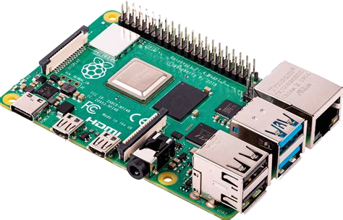
Hardware
The SADE device will be made from a Raspberry Pi 5 (a small but powerful ARM mini-computer) with 8GB of RAM running Ubuntu.
The Raspberry Pi will be equipped with a touchscreen module to make it accessible to people who cant use a keyboard and mouse and battery module to make it as portable as possible.
All of SADE’s software will be made free and open source (available to the general public for free to use or redistribute) under the MIT license and it will be usable with any machine with 4GB of RAM or above to use.
From reichelt.de

Slide 15
Existing Products

Slide 16
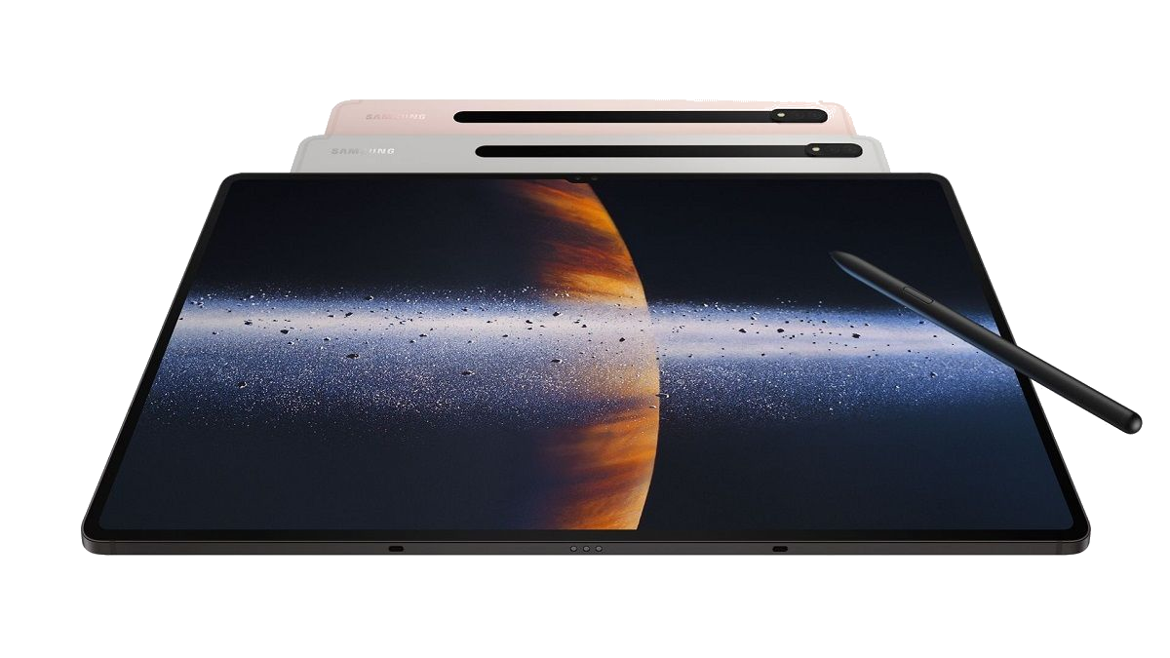
Tablets & Ipads
Tablets and iPads are touchscreen-based mobile devices that combine the functionality of a computer with the portability of a smartphone. When it comes to helping elderly individuals they can be particularly useful for the following reasons:
Portability: These devices are lightweight and can be easily carried around, making them suitable for use in different locations.
Communication: Tablets and iPads allow elderly individuals to stay connected with family and friends via video calls, voice calls, or messaging apps such as FaceTime, Skype, WhatsApp, and Facebook Messenger.
Entertainment: Tablets and iPads offer a wide range of entertainment options, including books, movies, music, games, and news. These devices can help keep elderly individuals engaged and entertained, which is essential for their mental well-being.
From 91mobile.com

Slide 17

Google Assistant and Siri
Both Google Assistant and Siri have features that can be particularly helpful for elderly people like they can set reminders, make phone calls and send text messages however they require a constant internet connection.
Google Assistant is available on a wide range of devices, including smart displays and tablets, which can make it easier for elderly people with vision impairments to use the device.
Siri can also read out messages or emails, which can be useful for those with visual impairments or difficulty reading small text. Siri is exclusively available on Apple devices like the Homepod, iPad and iPhone.
From Apple Fandom

Slide 18

Google Gemini and Bing Copilot
Google Gemini AI and Bing Copilot AI are artificial intelligence (AI) models that aim to enhance search engine capabilities and provide users with more personalized, relevant, and helpful information. However neither of these texhnologies were made with the elderly in mind and both of them require internet and store your data on Microsoft or Google servers.
Google Gemini AI is an LLM model developed by Google, designed to understand natural language and generate human-like responses. This AI technology aims to provide users with more personalized and helpful information based on their queries.
Bing Copilot AI is an AI-powered search engine feature developed by Microsoft. It aims to provide users with a more interactive and personalized search experience by analyzing their queries and offering relevant information, suggestions, and visual aids.
From brandlogo.org

Slide 19
Products Comparison:
c
Tablets | Google Assistant and Apple Siri | Google Gemini and Bing Copilot
8 / 10 | 5 / 10 | 7 / 10
Does not provide the unified design that SADE will and are generally more expensive. | They requires a constant connection to the internet and all models and data are being kept by a large company. | They do not provide full voice-assistant functionality and they require a constant internet connection and data is being kept by a large company.

Slide 20
Questionnaire The questionnaire was given out to about 50 people during the Zimbabwe Science Fair. The majority of the respondents were young between the age of 10 - 18 however some were teachers from attending schools. The following are the results in pie chart form :

Slide 21
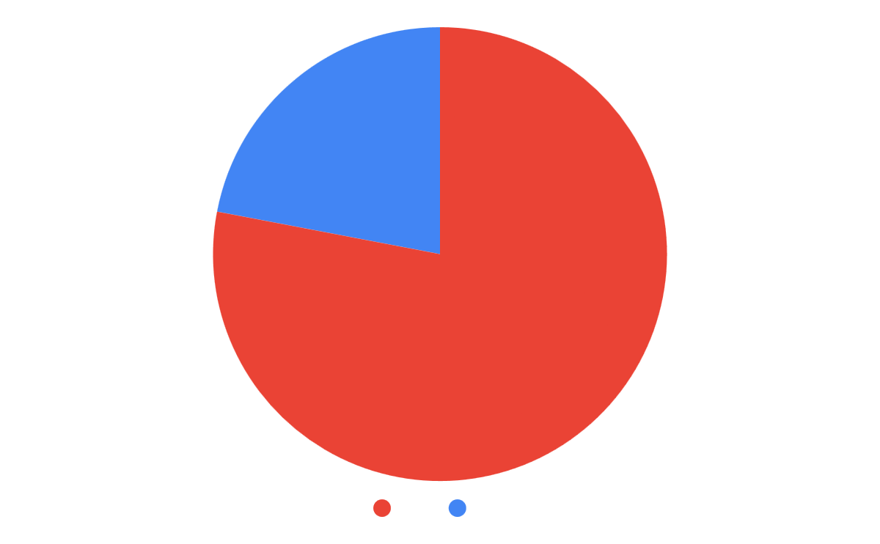
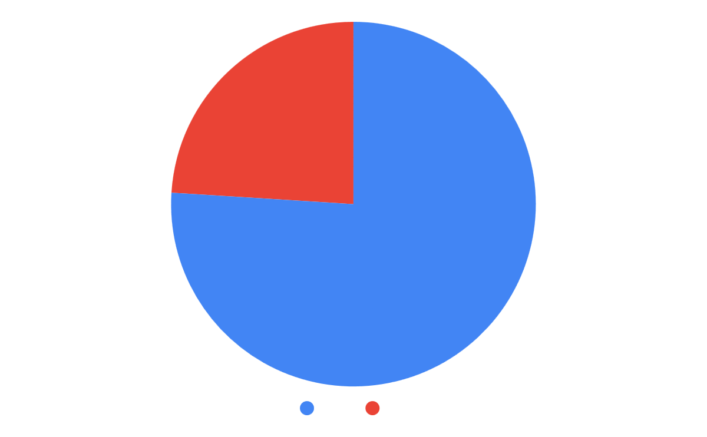
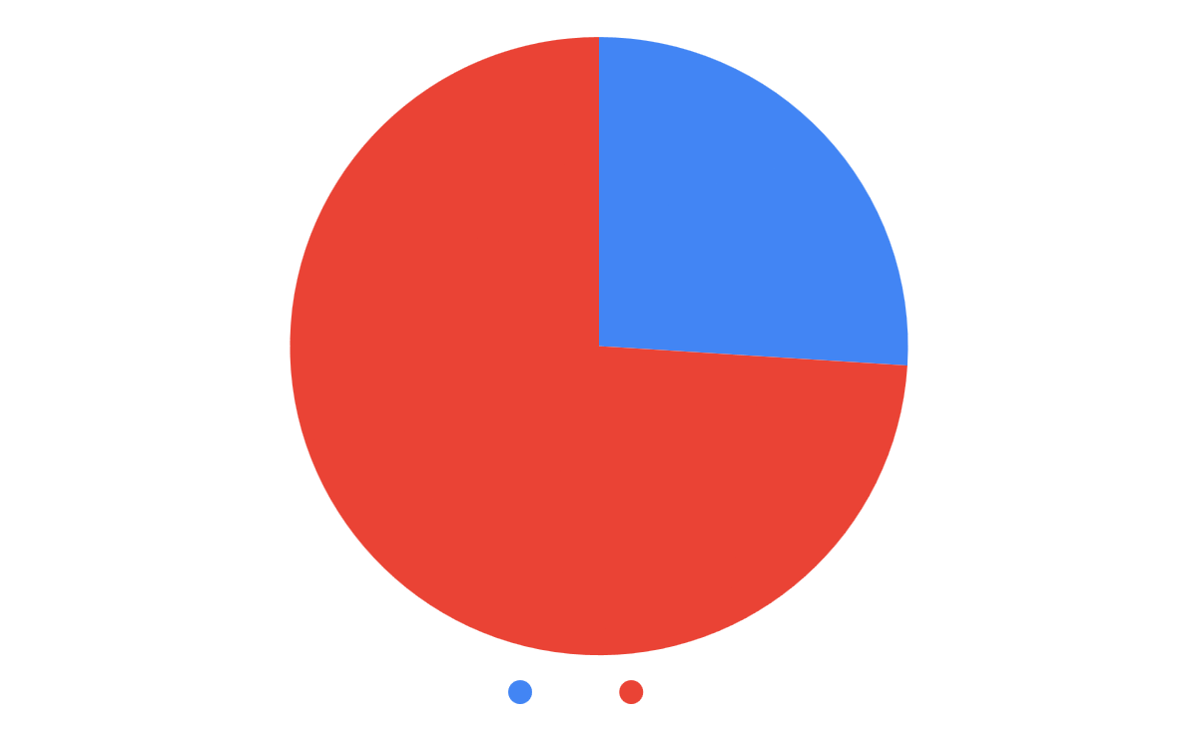
Do you struggle with current technology like laptops or tablets? |  | This shows that young people are capable in using laptops and tablets.
Do you have a parent or grandparent who struggles with technology like tablets or laptops? |  | This shows that older people should be the prioritized market for SADE.
Do you or someone you know have arthritis? |  | This shows that arthritis isnt common in Zimbabwe but still has a sizeable amount of individuals suffering from it.

Slide 22
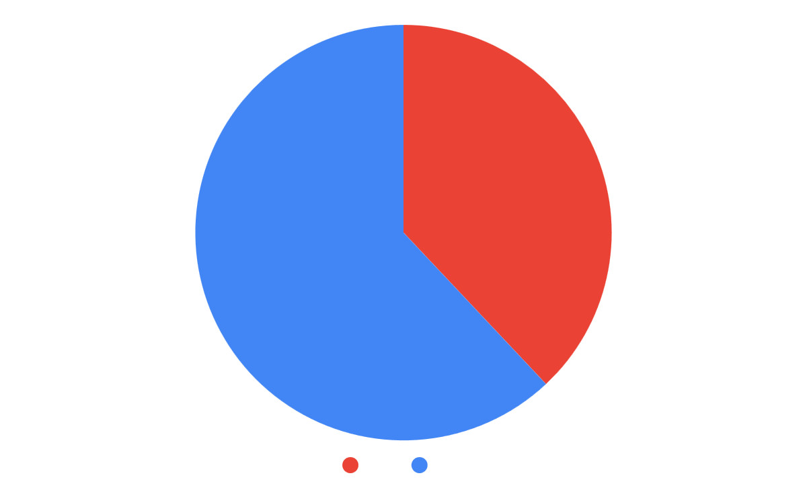
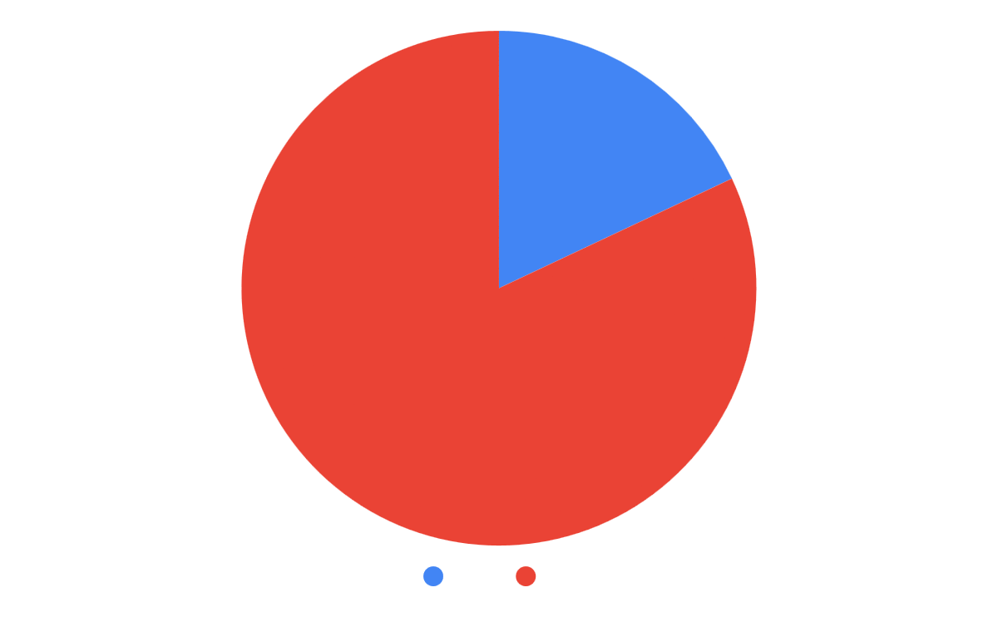
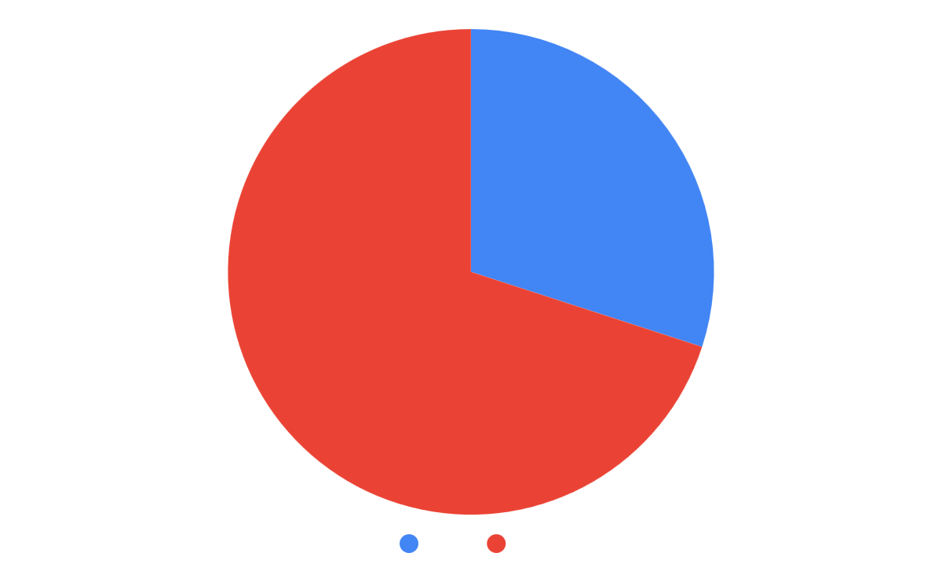
Do you or someone you know struggle from vision loss? |  | This shows that vision loss victims should be the priority when developing SADE.
Would you or someone you know benefit from having an offline voice assistant? |  | This shows that an offline voice assistant appeals to a small but sizeable amount of people and could possibly benefit them.
Would you or someone you know benefit from an smart device with an assistant to help manage their daily online life? |  | This shows that there is a decent market for the device.

Slide 23
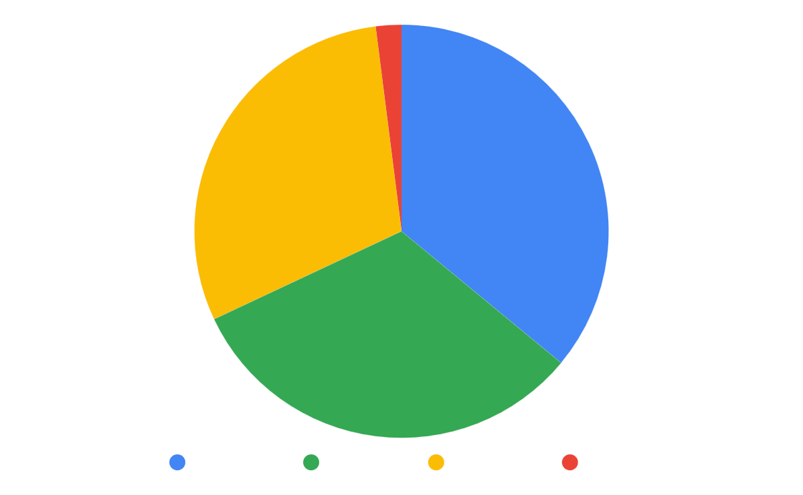
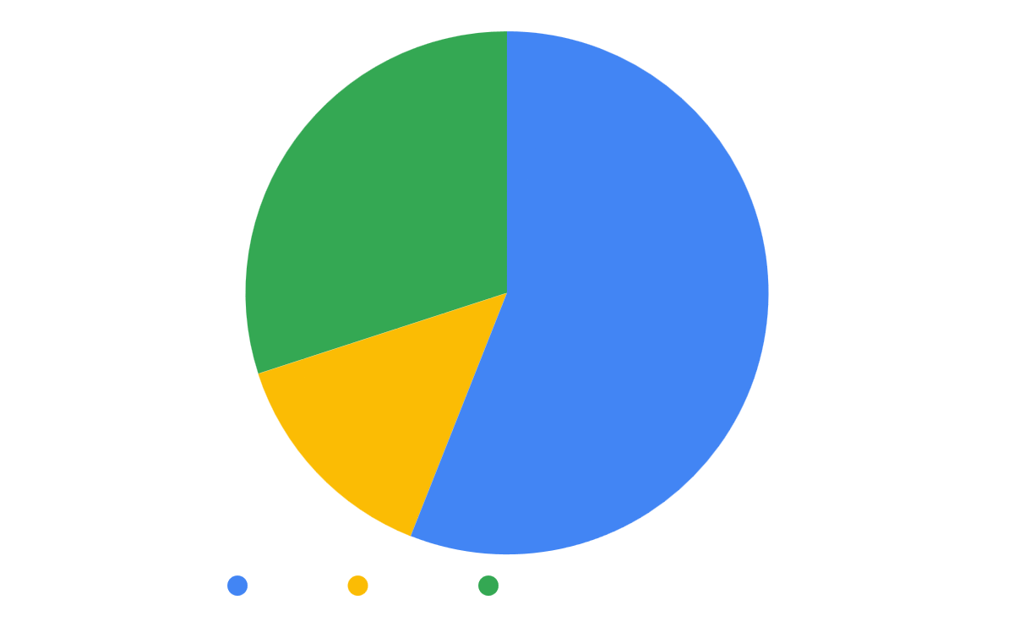
How much would you be willing to pay for the smart device in the previous question, in USD? |  | This shows that my device will have to cost below $150.
What materials would you want the smart device to be made from? |  | This shows that people generally prefer to have devices made from metals but due to cost restraints it will have to be smart materials.

Slide 24
Parts Research

Slide 25
Main Board
Raspberry Pi 5 https://www.raspberrypi.com/products/raspberry-pi-5/ | Radxa Rock 5 https://radxa.com/products/rock5/5b/ | $100 Laptop Motherboard
8 / 10 | 7 / 10 | 4 / 10
A lot of pre-existing compatable addons (hats) already available. Large active community ready to help with any issues | Comes with a dedicated AI processing unit pre-installed. Potential Instability with certain addons due to lack of userbase. | Used boards would perform better than any other options for the price. Zero support for any existing addons. Would have no substantial support. Would take up more surface area.
The logical option for this project is therefore the Raspberry Pi 5 for the reasons mentioned above.

Slide 26
Screen
This research shows two potential and good options, the Waveshare 7” and BTT 4.3” screens so therefore I will create ideas for both and the unique advantages of their form factors.
Official Pi 7” Screen https://www.raspberrypi.com/products/raspberry-pi-touch-display/ | Waveshare 7” Screen https://www.waveshare.com/wiki/7inch_DSI_LCD_(C) | BTT Pi 4.3” Screen https://bttwiki.com/TFT43-DIP.html
6 / 10 | 4 / 10 | 8 / 10
The most supported by the Pi 5 because they are made by the same company Substantially higher cost to get in Africa forcing prices of the device up. Large size may reduce portability for the device and force it to compete with pre-existing tablets. | Friendly and readily available support provided. More expensive than the 4.3” screen because of larger size. Large size may reduce portability for the device and force it to compete with pre-existing tablets. | Least expensive of the options. Small size allows it to easily portable. Very little support given and poor documentation. Small size may make it difficult to use for people with poor eye-sight.

Slide 27
Ideas

Slide 28
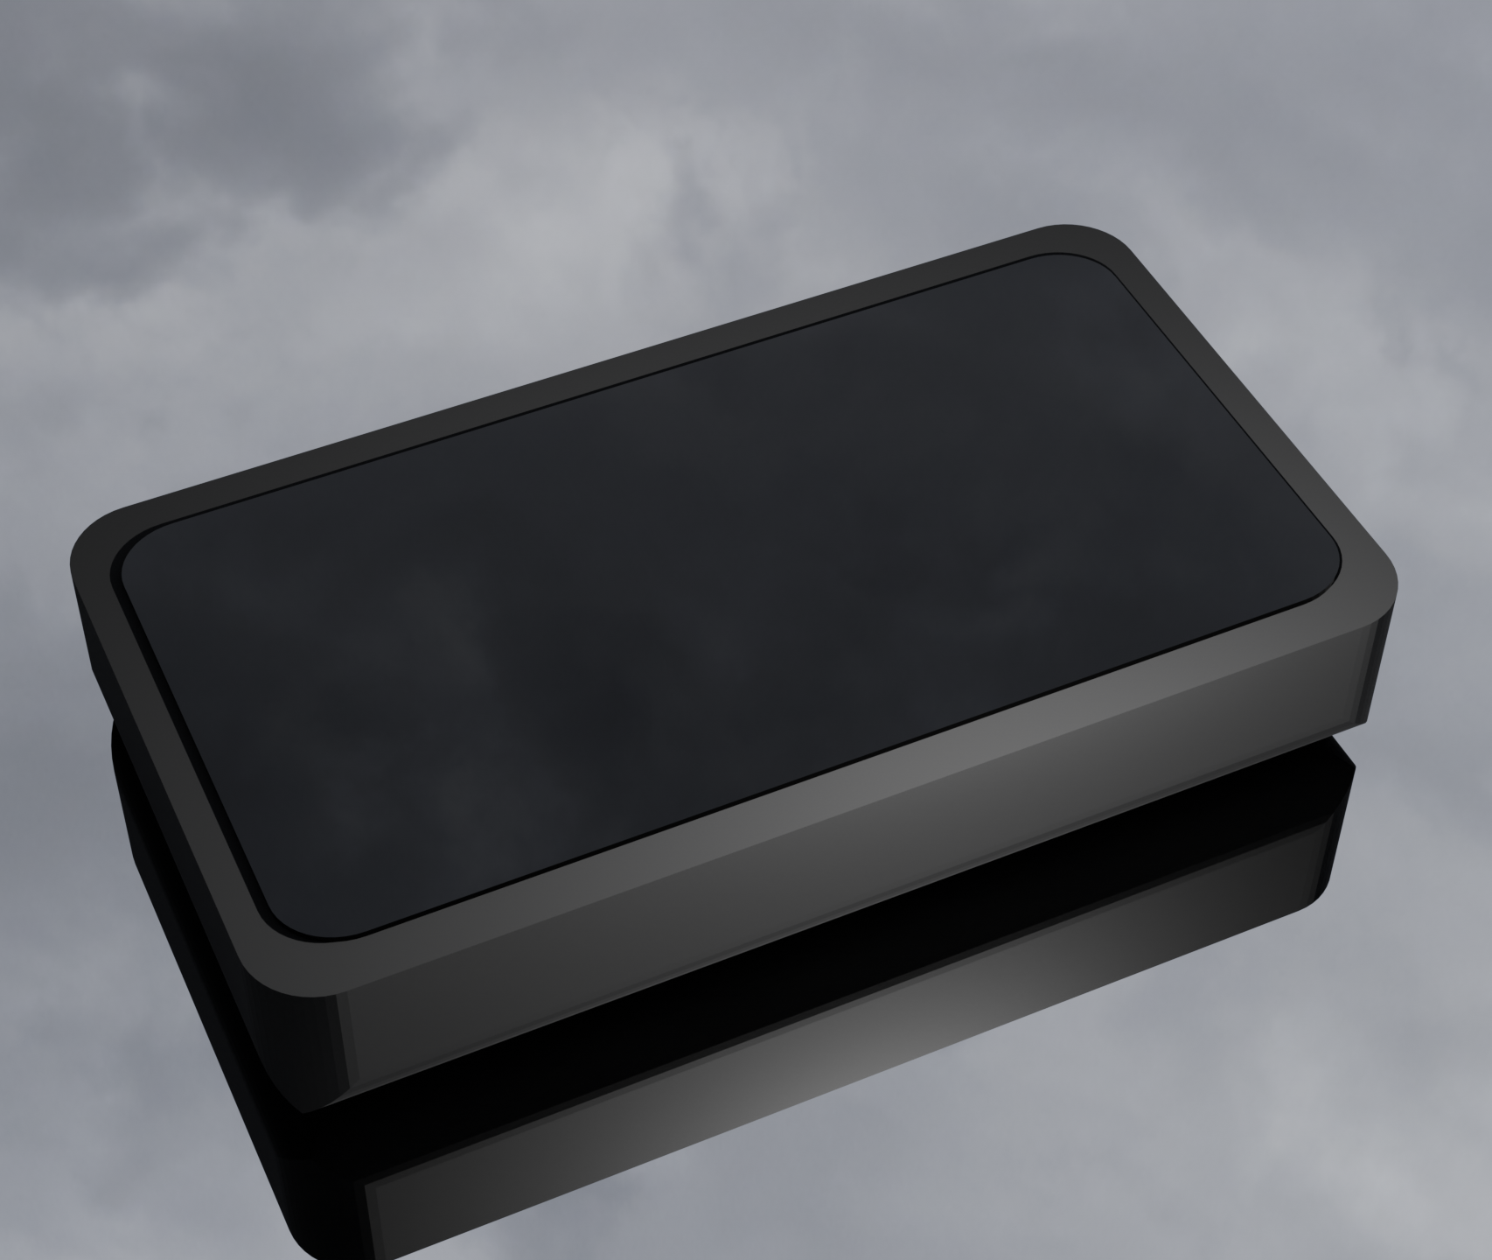
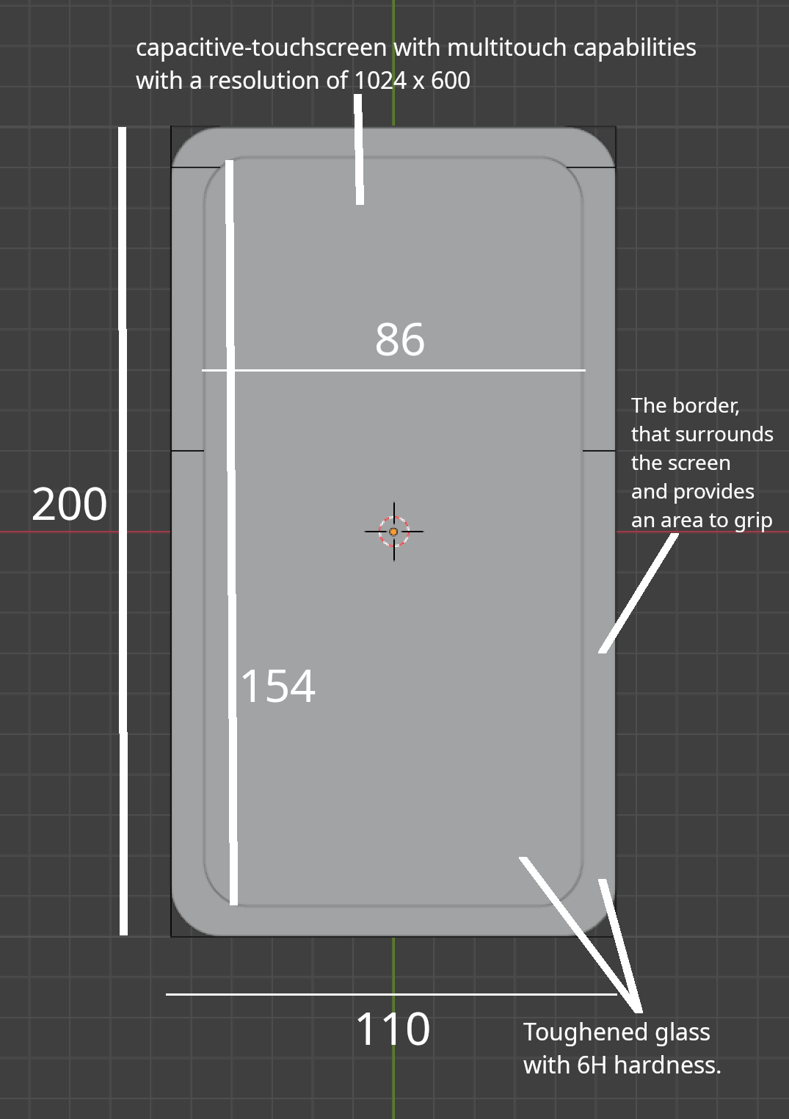
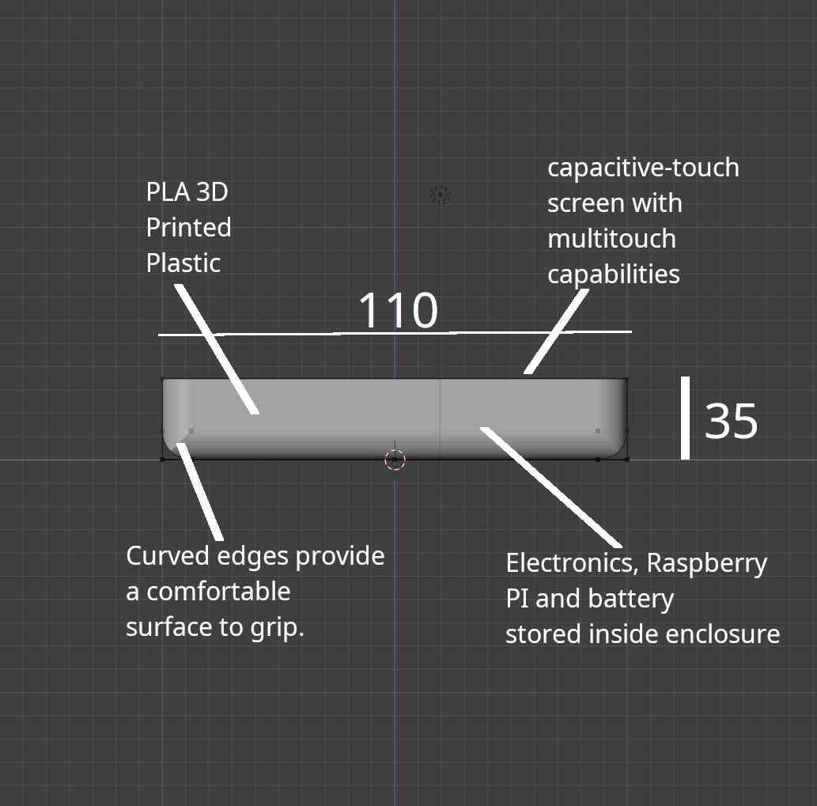
Idea 1
A simple easy-to-manufacture tablet-like design.
Render
Front View
Side View

Slide 29
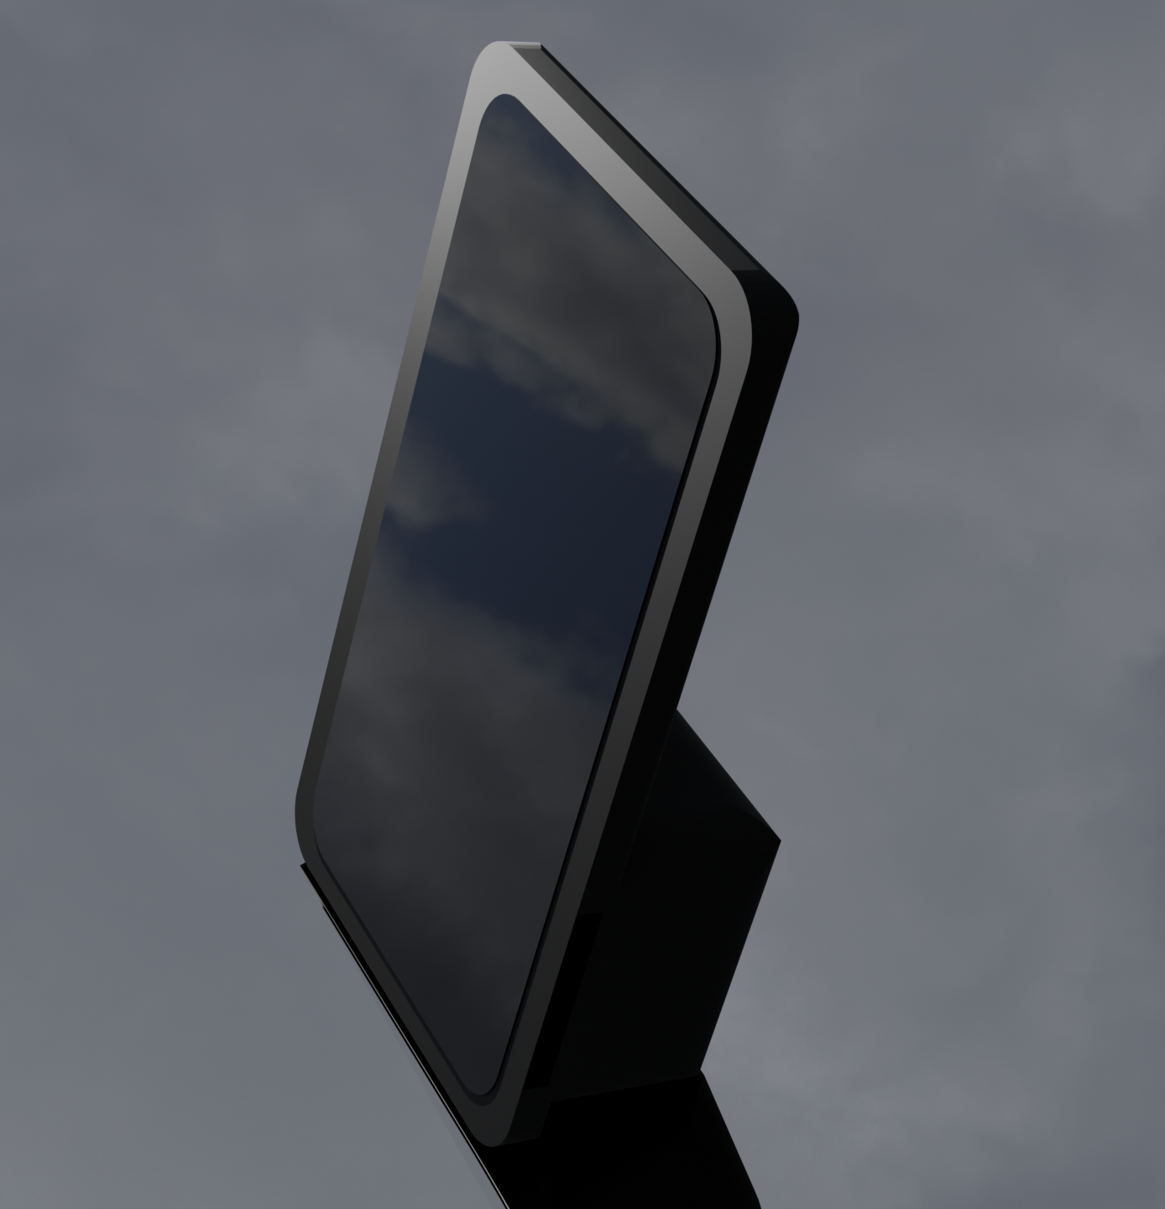
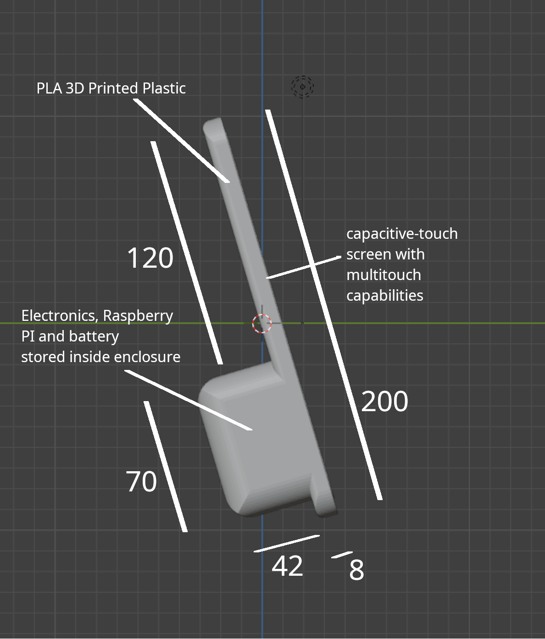
Idea 2
A simple tablet-like design with all the logic components being held in one area of the tablet.
Render
Front View
Side View

Slide 30
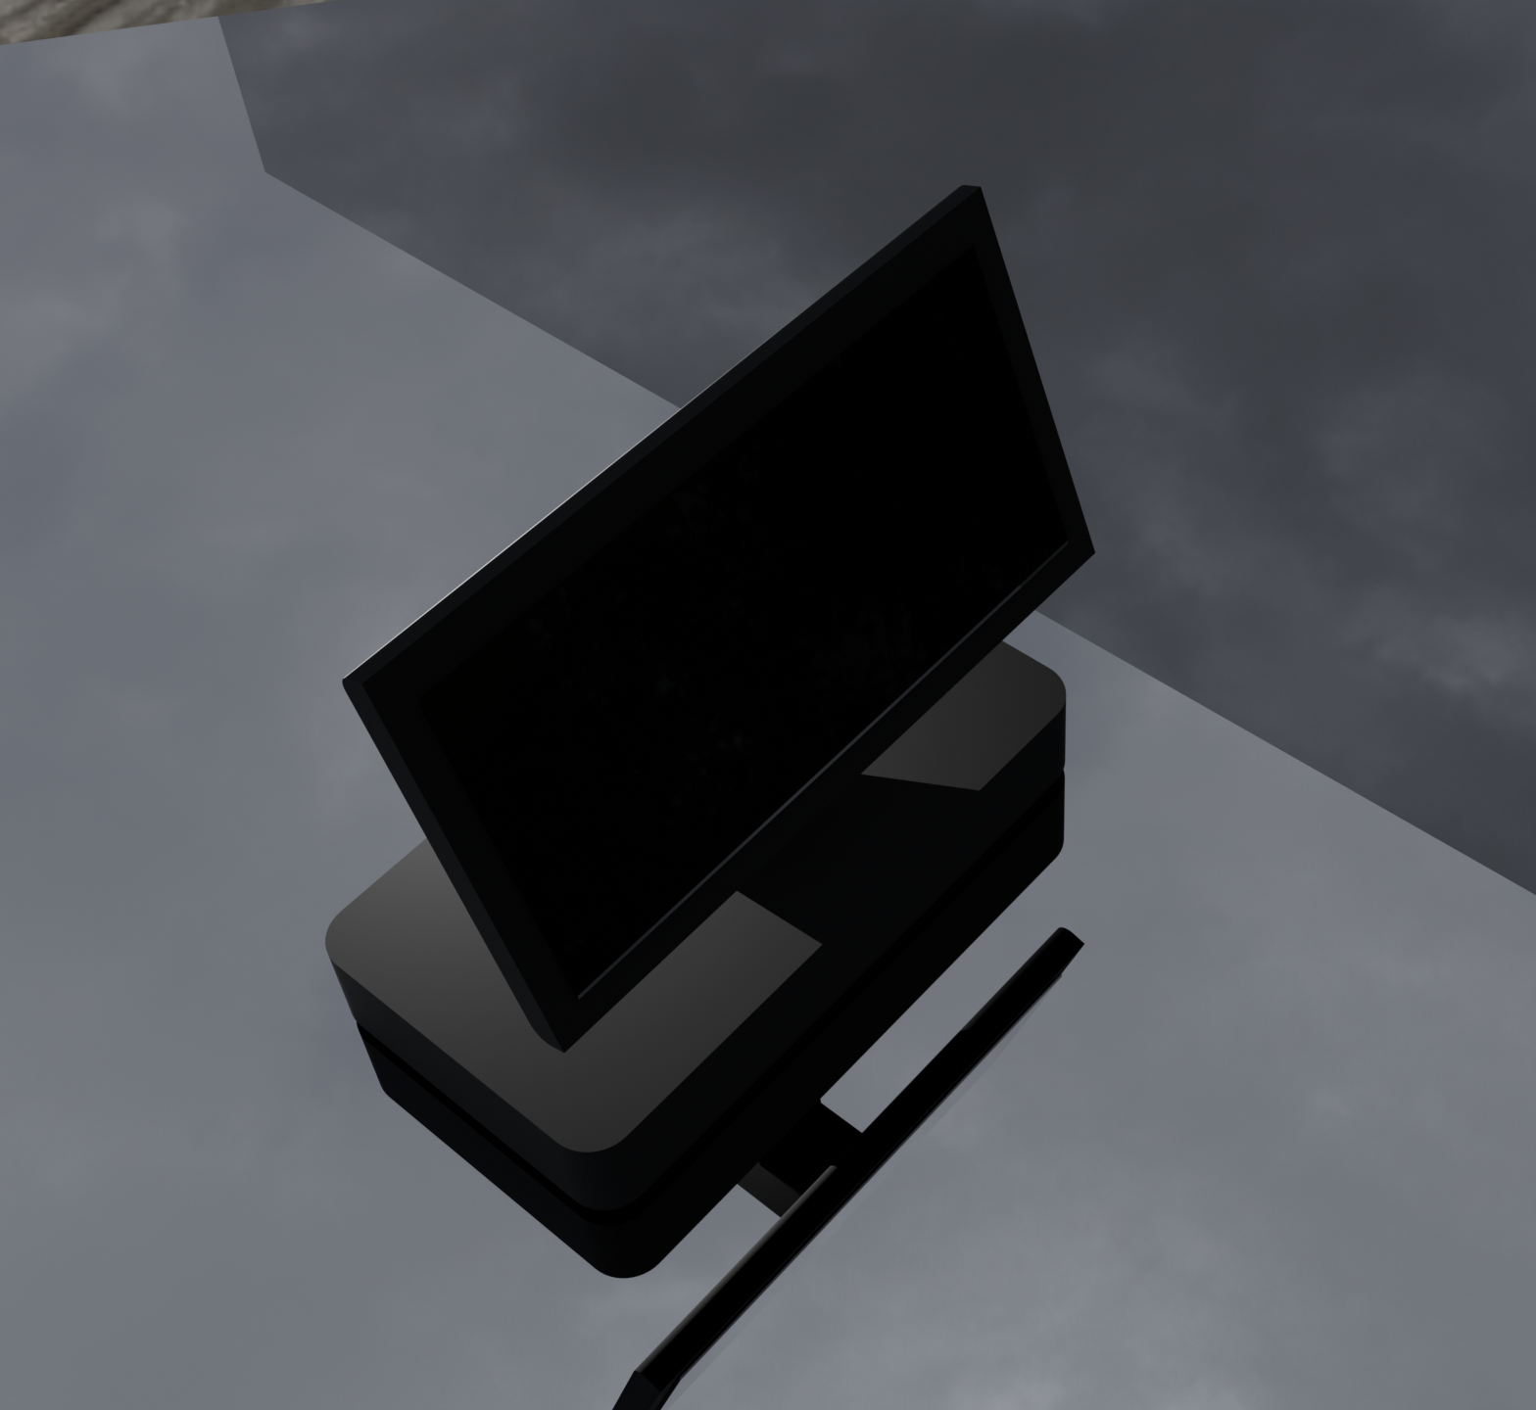
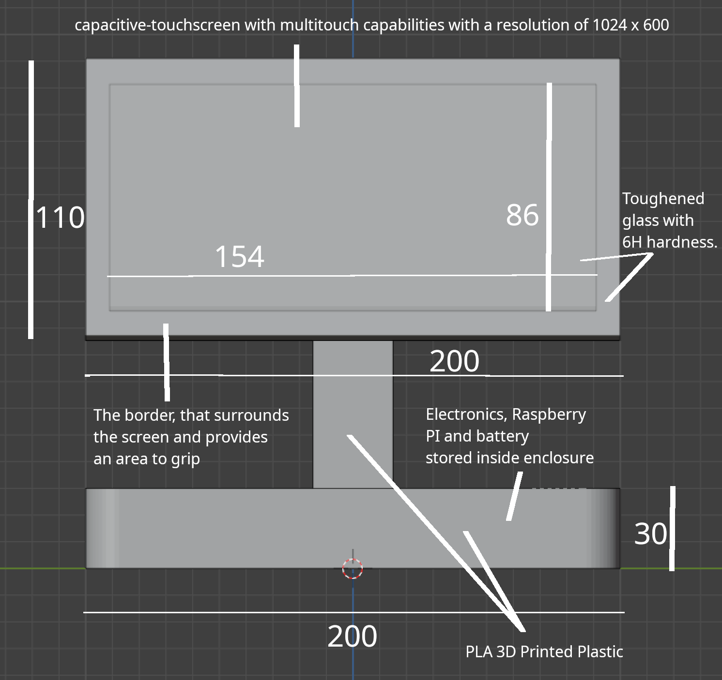
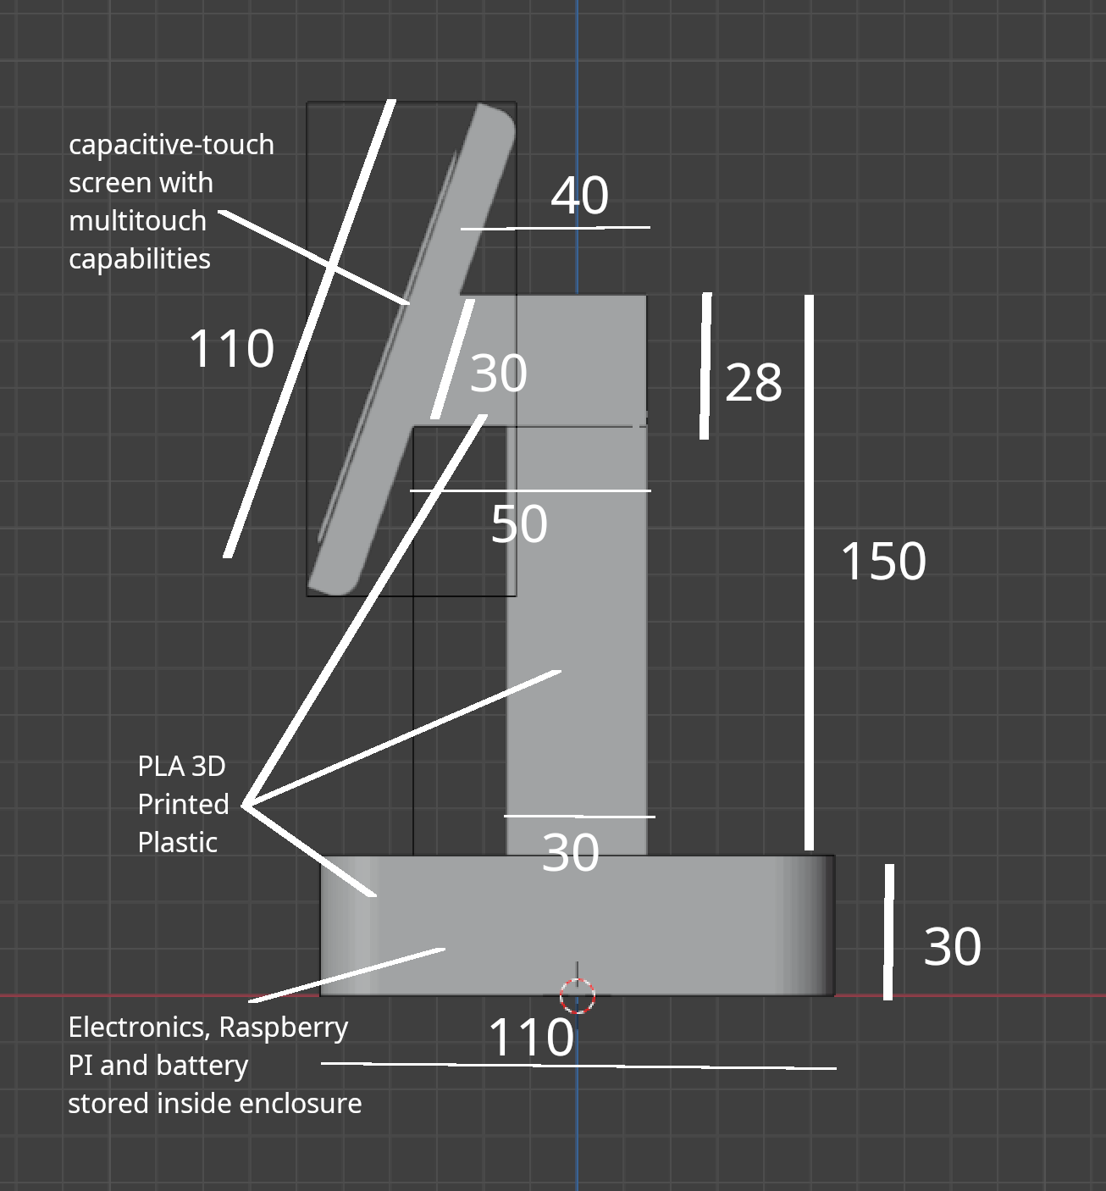
Idea 3
A table-top mini all-in-one computer design.
Render
Front View
Side View

Slide 31
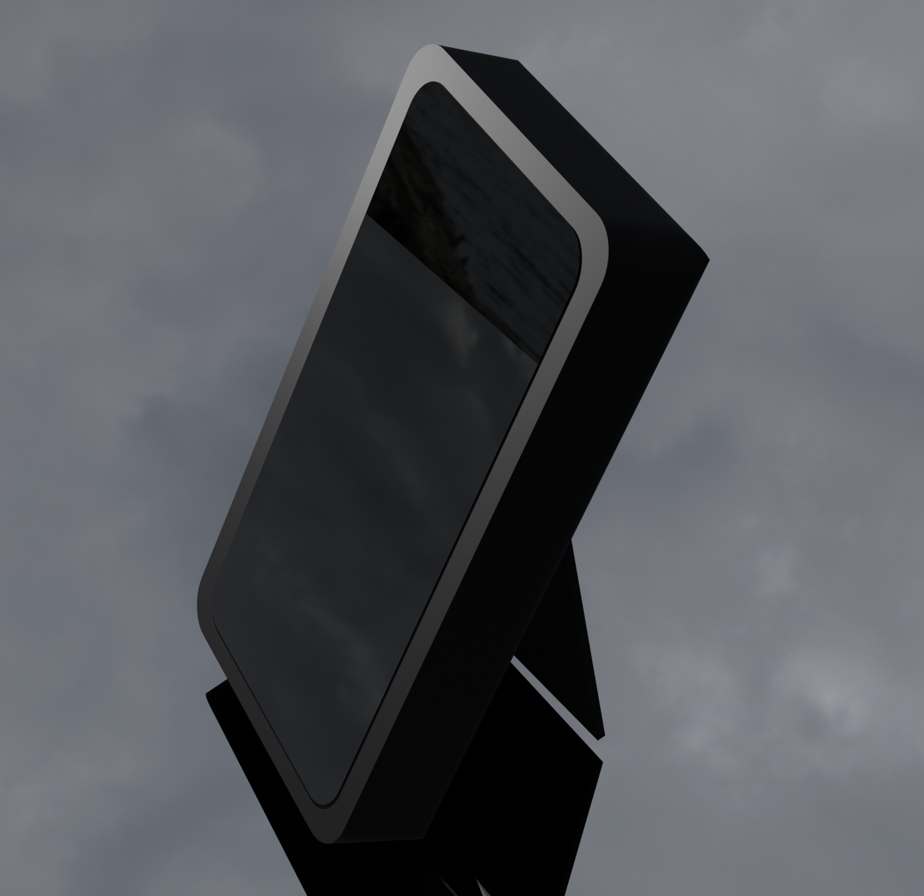
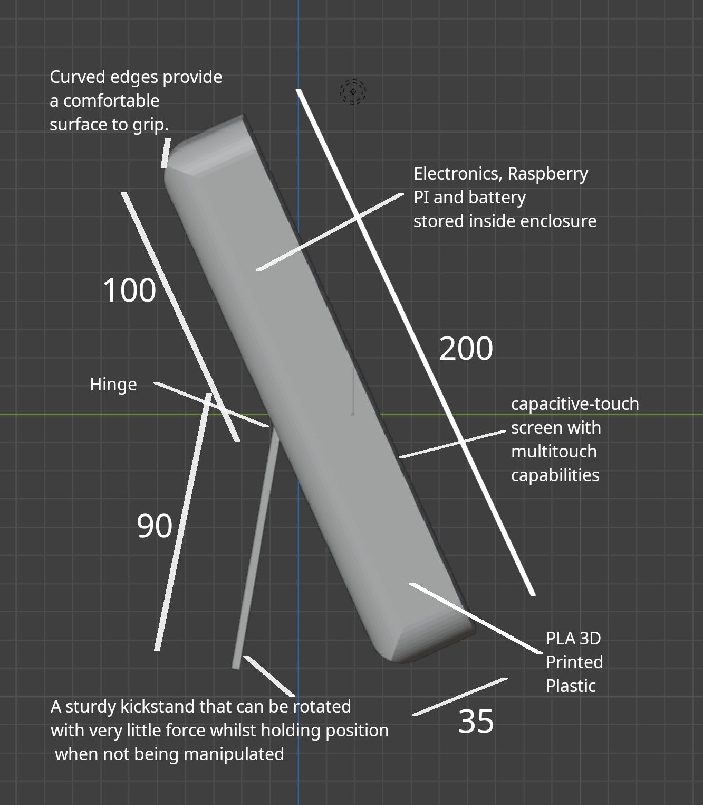
Idea 4
A simple tablet-like design with a kickstand.
Render
Front View
Side View

Slide 32
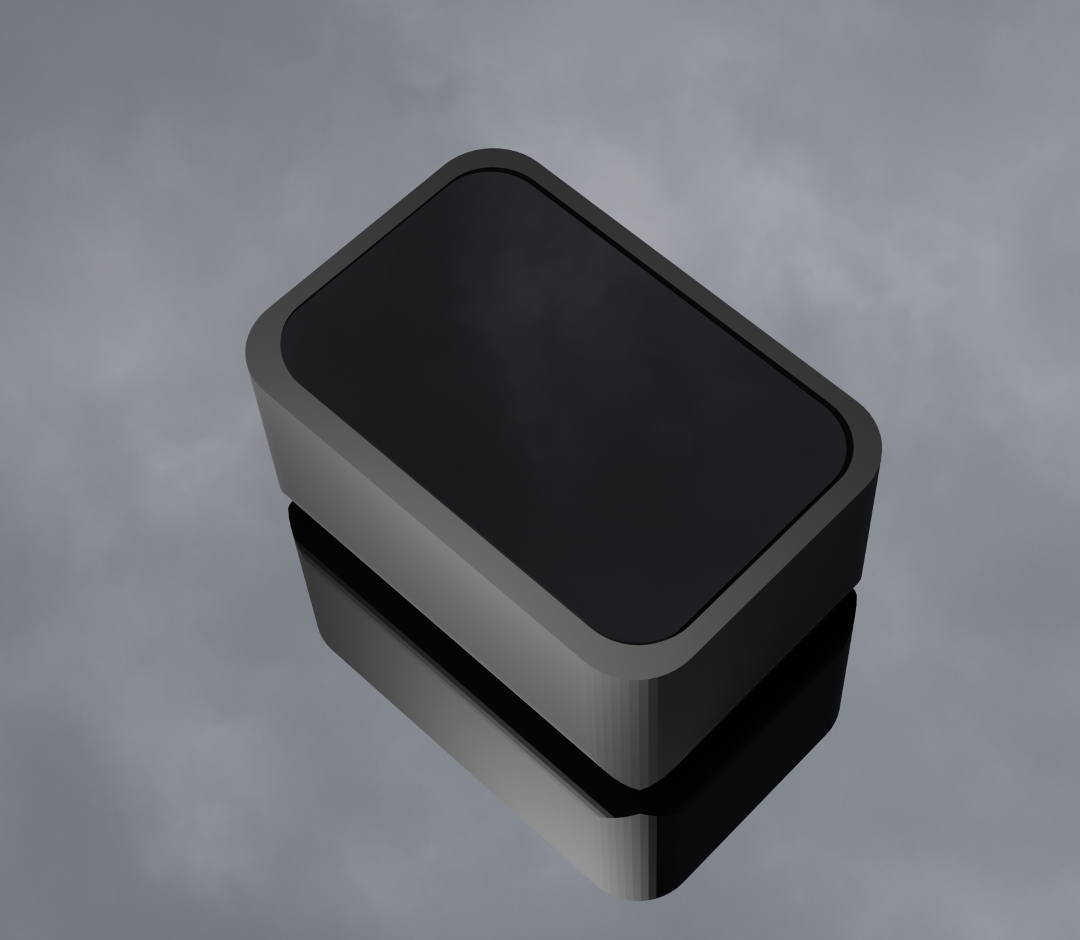
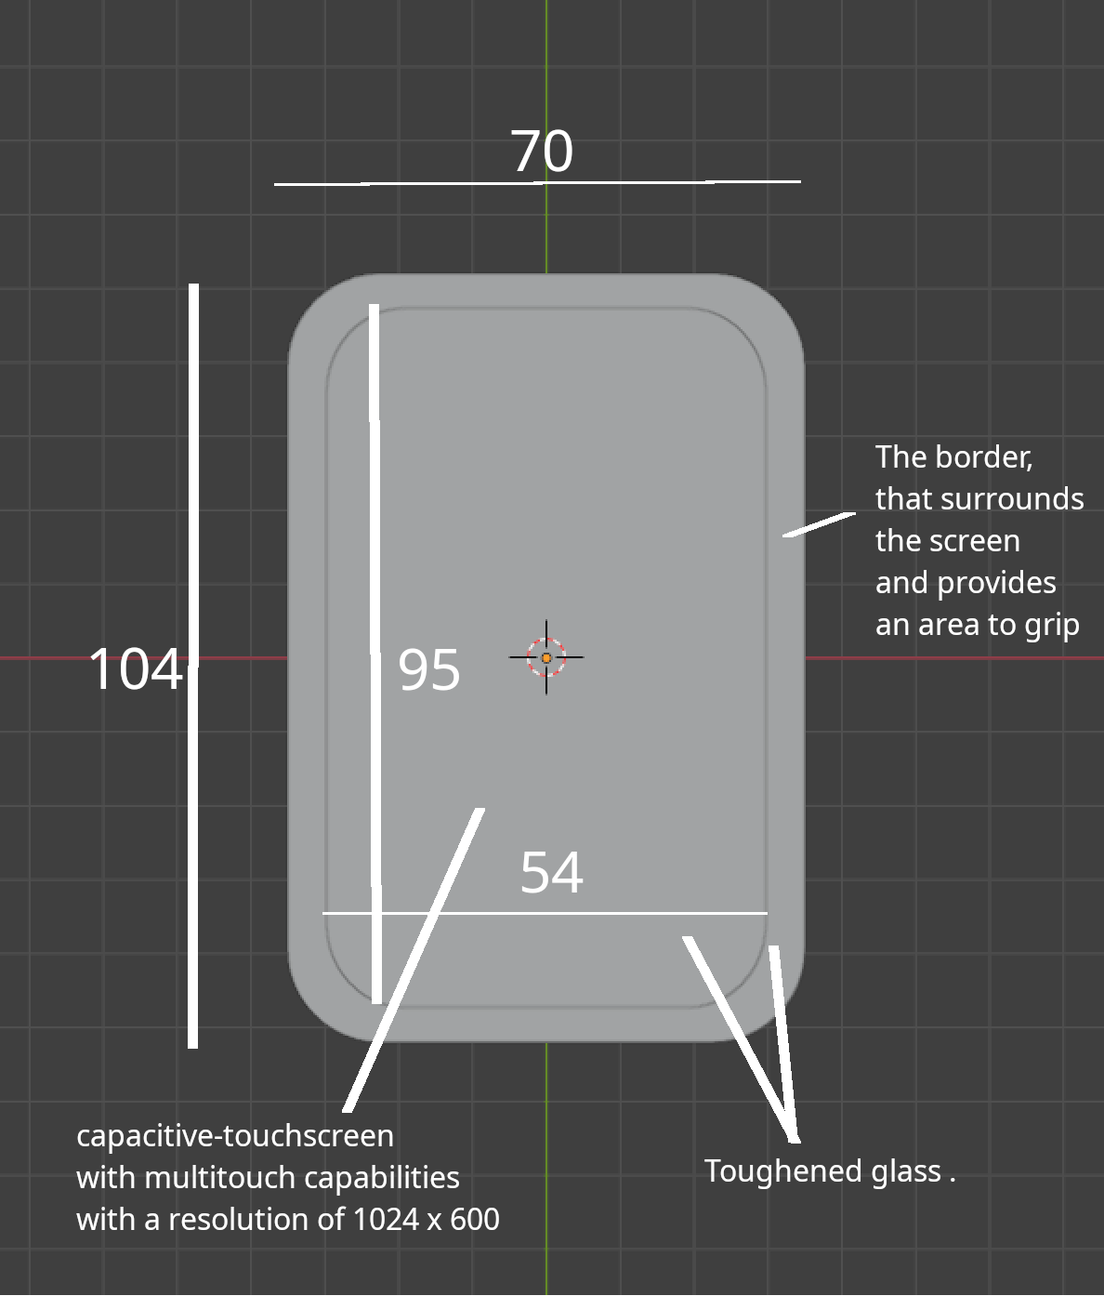
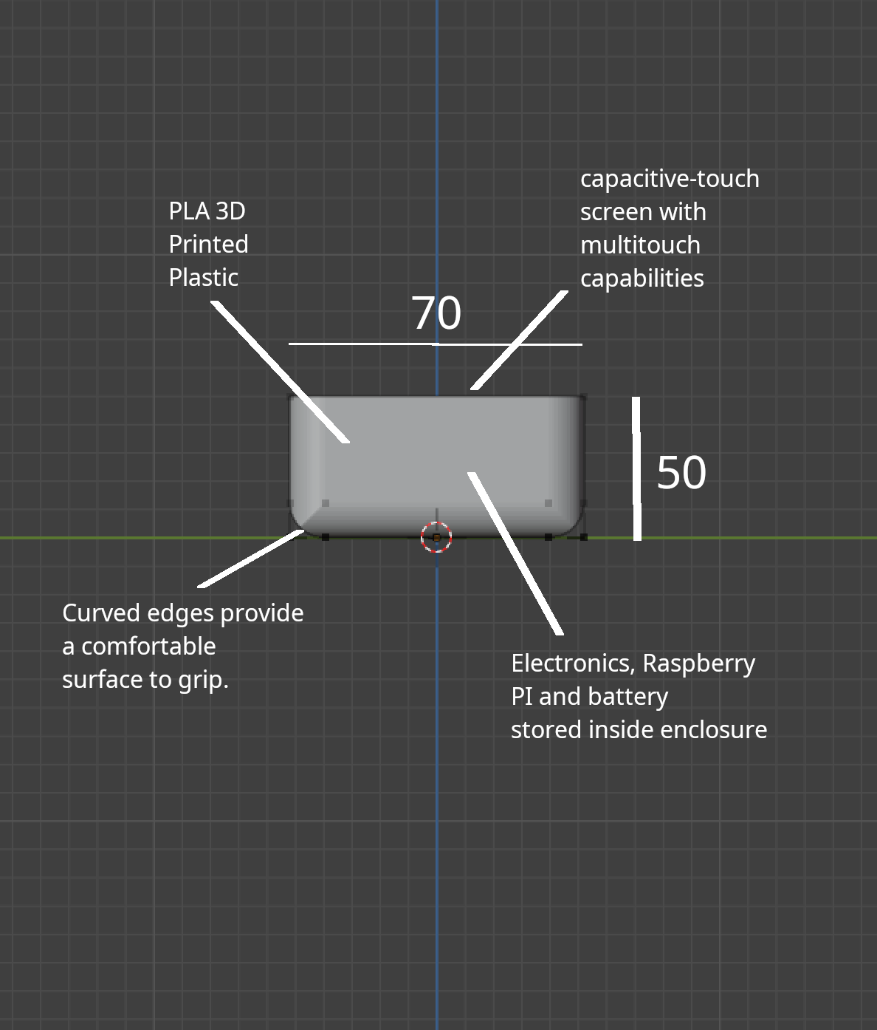
Idea 5
A small pocketable design.
Render
Front View
Side View

Slide 33
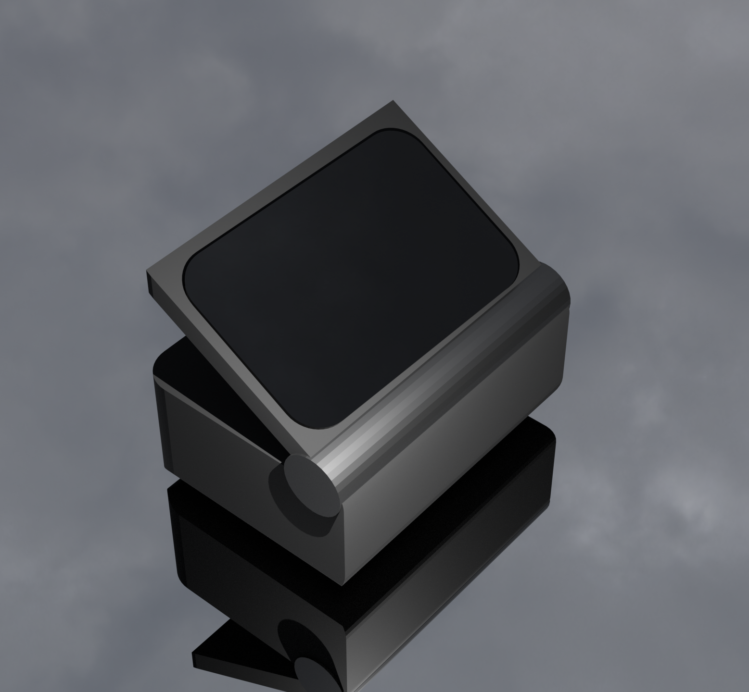
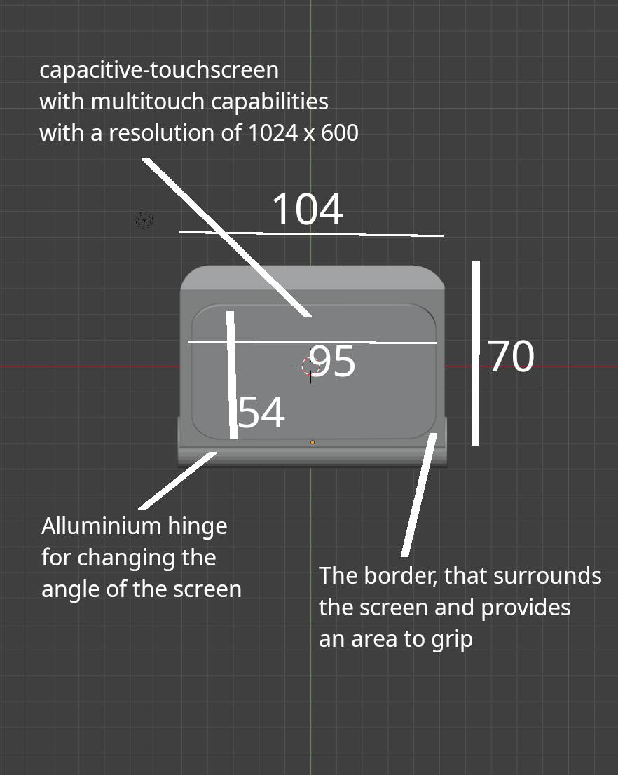
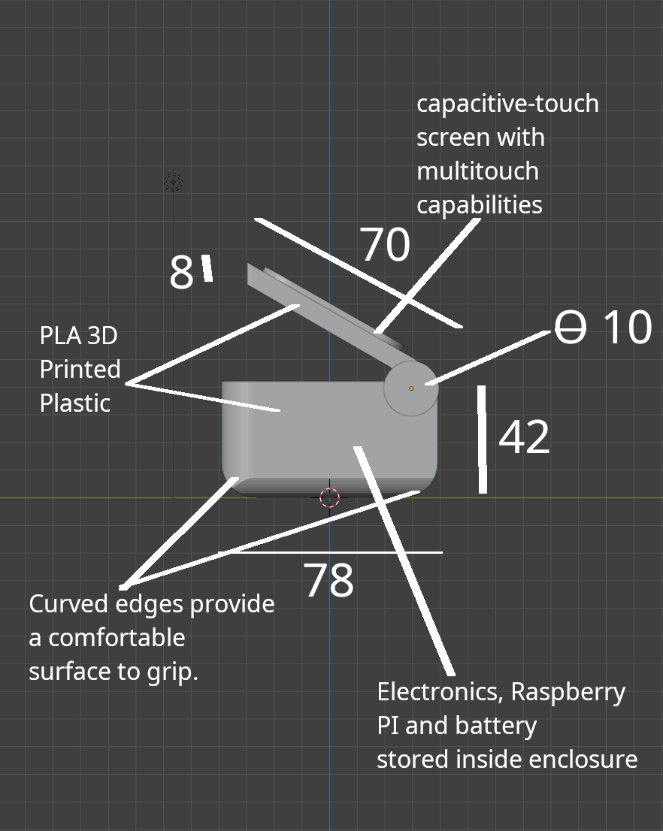
Idea 6
A small pocketable design with adjustable screen angle.
Render
Top View
Side View

Slide 34
Ideas Analysis
Idea 1 | Idea 2 | Idea 3
5 / 10 | 7 / 10 | 3 / 10
Has no moving parts that could break. | Allows the device to stay upright on a desk. Has no moving parts that could break. | Allows the device to stay upright on a desk. Has no moving parts that could break. It lacks the portability of any of the other devices. Has a weak column that holds up the screen that could break if incorrectly handled.

Slide 35
Idea 4 | Idea 5 | Idea 6
6 / 10 | 9 / 10 | 8 / 10
Allows the device to stay upright on a desk. Provides an adjustable viewing angle. Has movable parts could lead to a potential point of failure after heavy use. | Is small enough to fit in a pocket making it extremely easy to carry around. Used less materials due to its smaller size. Small size could make it difficult to see for people with poor eyesight and difficult to use for people with arthritis. | Allows the device to stay upright on a desk. Provides an adjustable viewing angle. Is small enough to fit in a pocket making it extremely easy to carry around. Used less materials due to its smaller size. Has movable parts could lead to a potential point of failure after heavy use.

Slide 36
Chosen Idea Idea 5

Slide 37
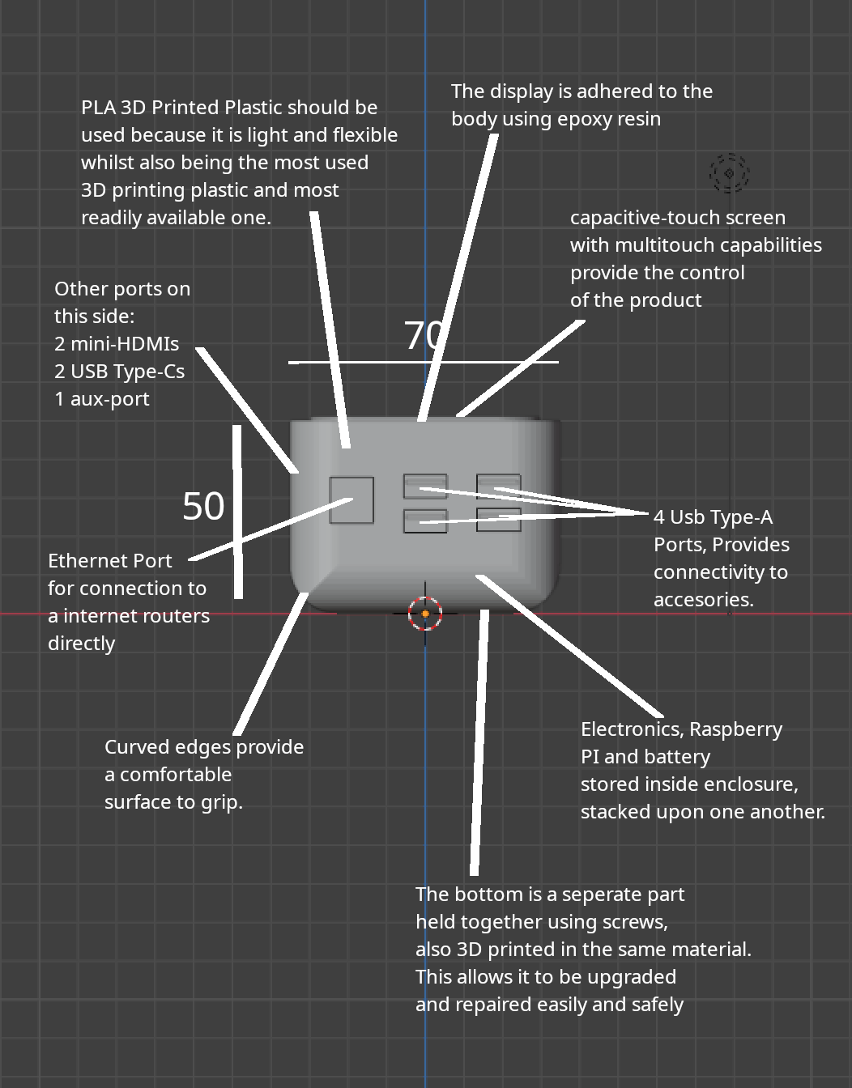
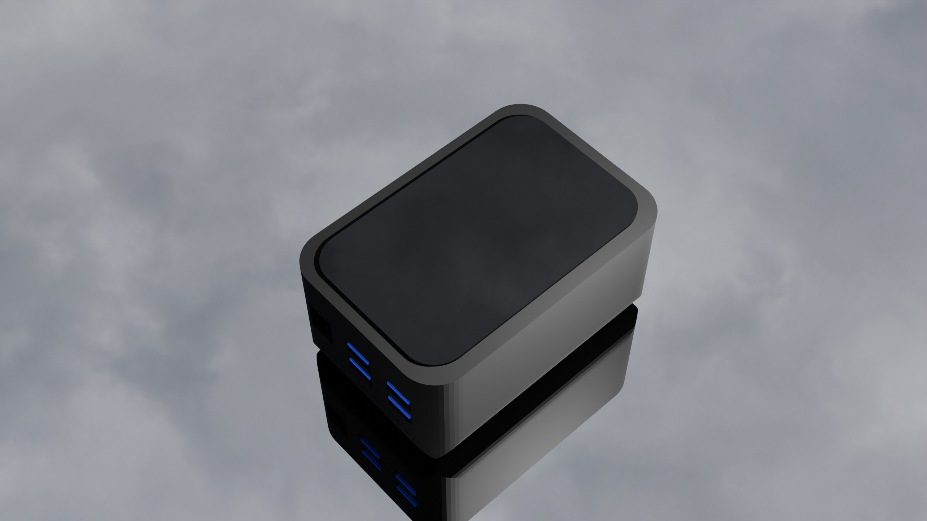
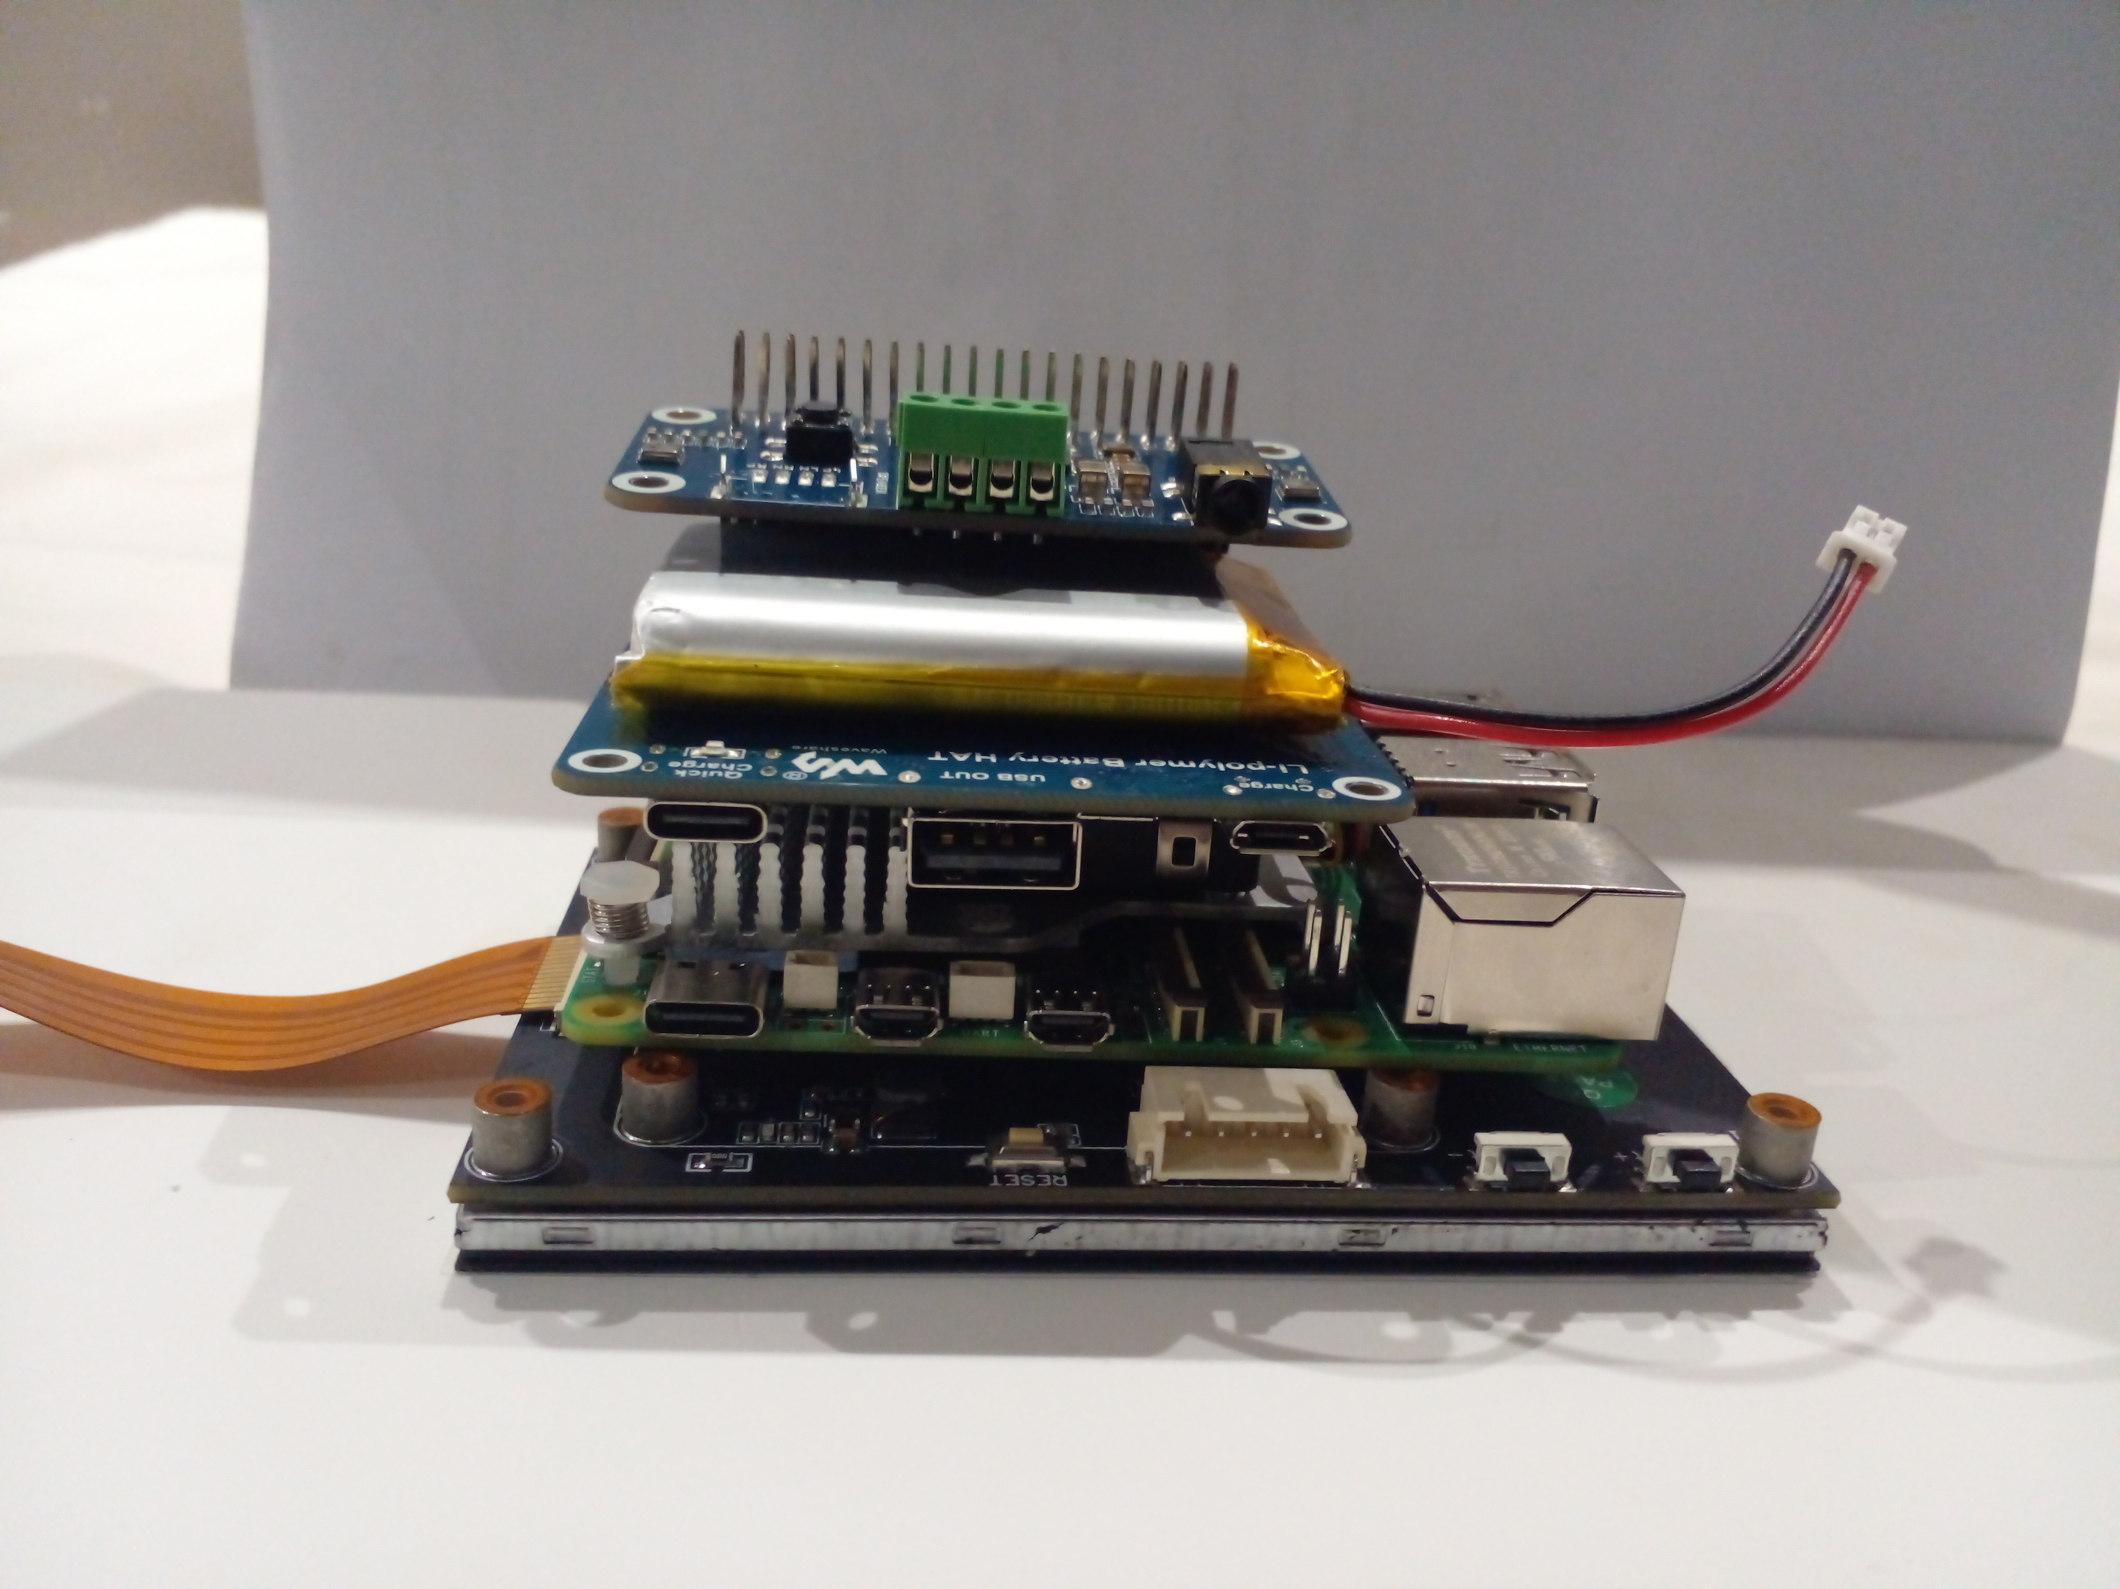
A small pocketable design with lots of connectivity.
Front View
Side View
Render
Overall Size:
200 x 110 x 50
Manufacturing:
The enclosure will be 3D Printed because it is consistent and can be easily repeated for batch or continuous manufacturing. However this also means that the enclosure cannot be easily recycled.
Improvements:
Added access to ports to allow for accessories
All the parts and addons of the project stacked upon one another, in the configuration they would have in the finished product.

Slide 38
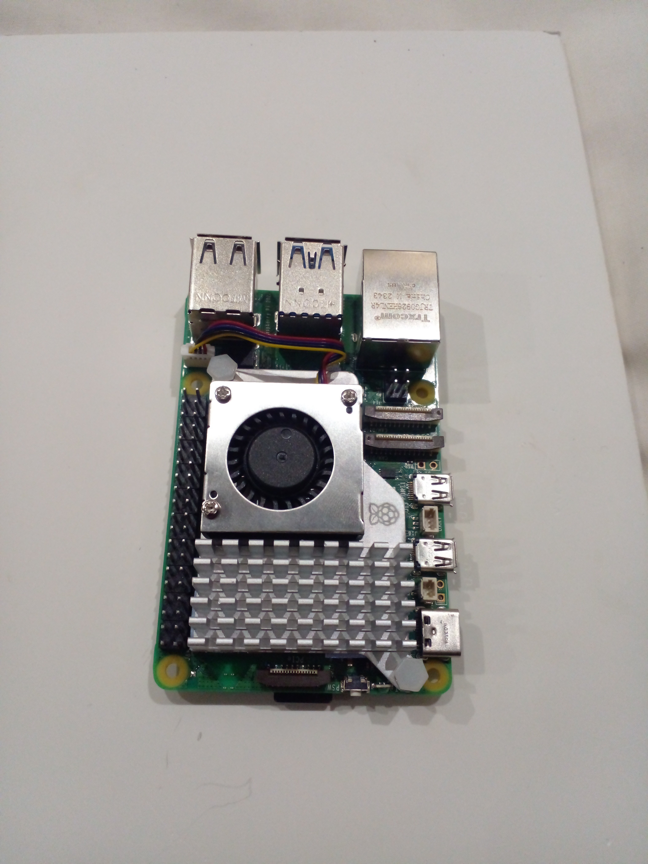
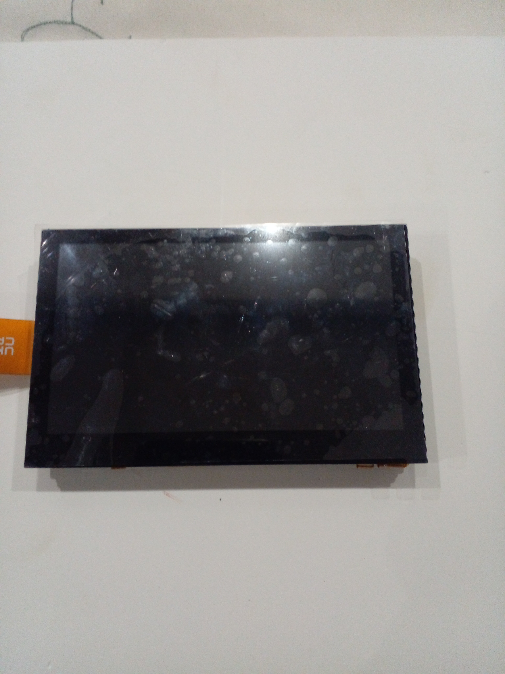
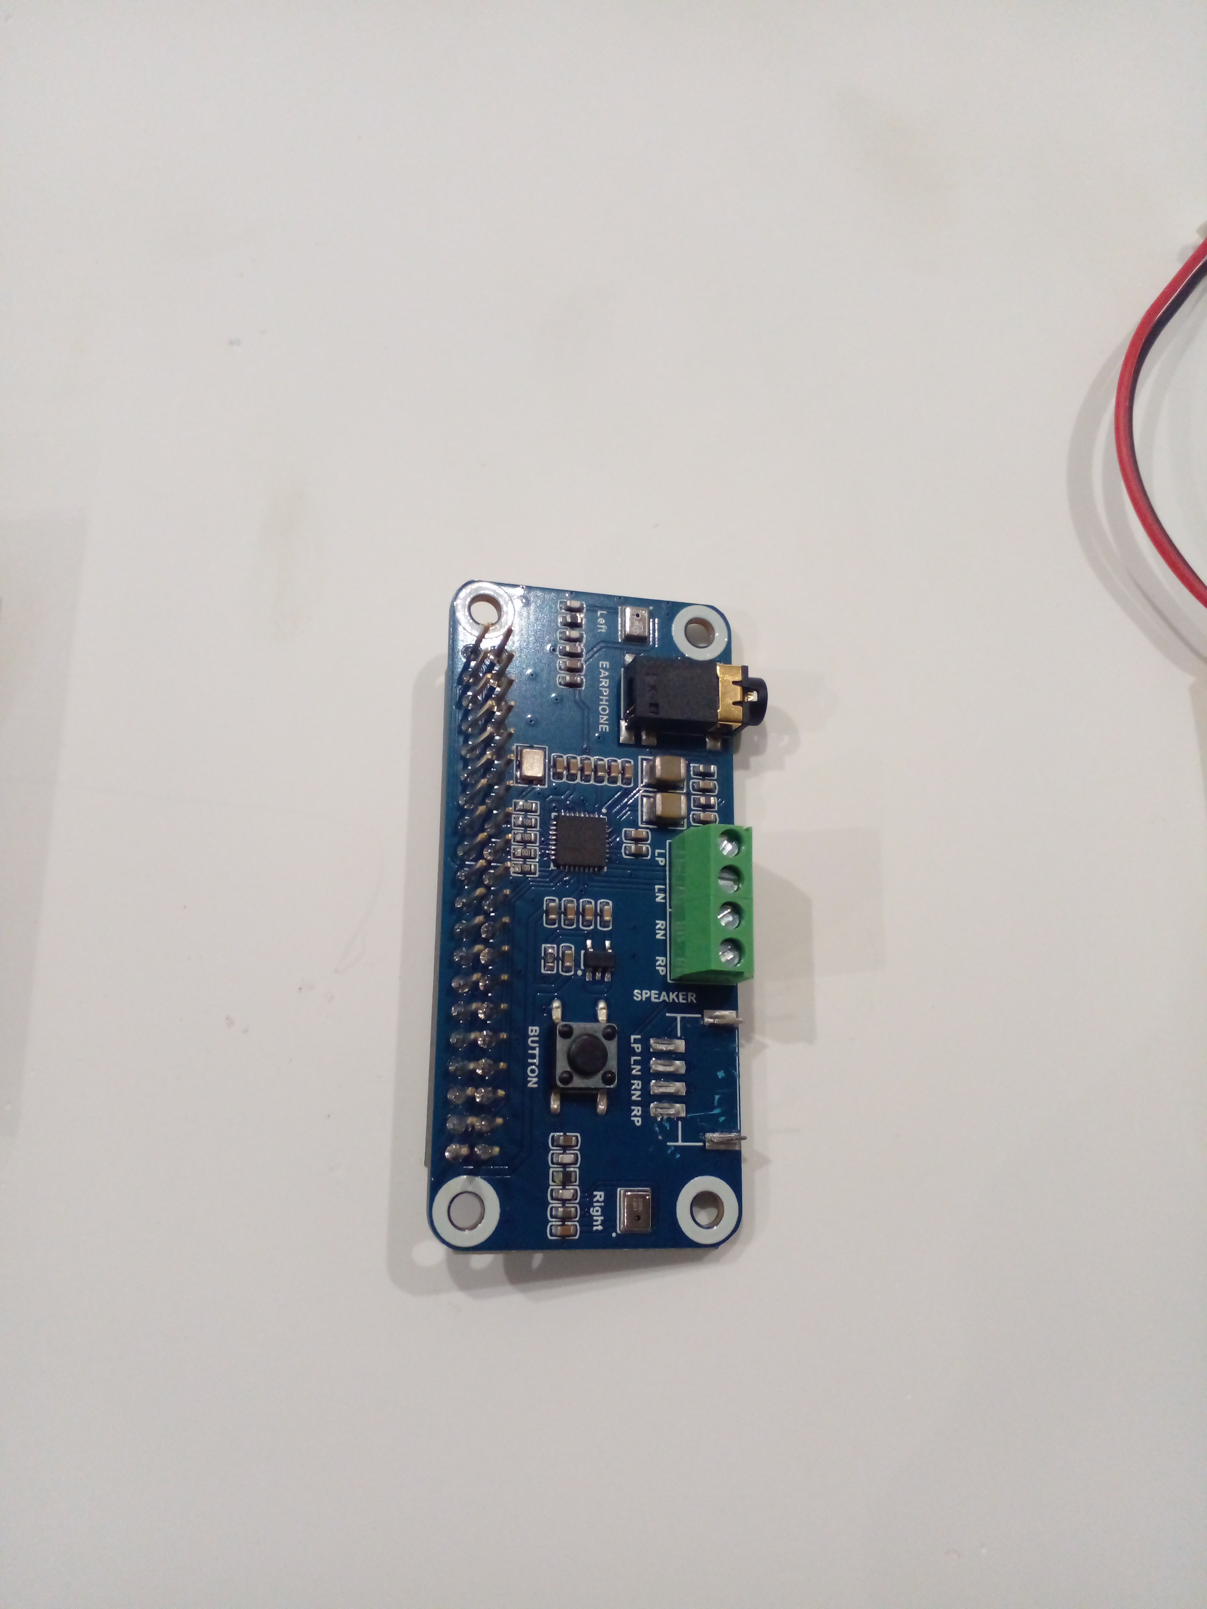
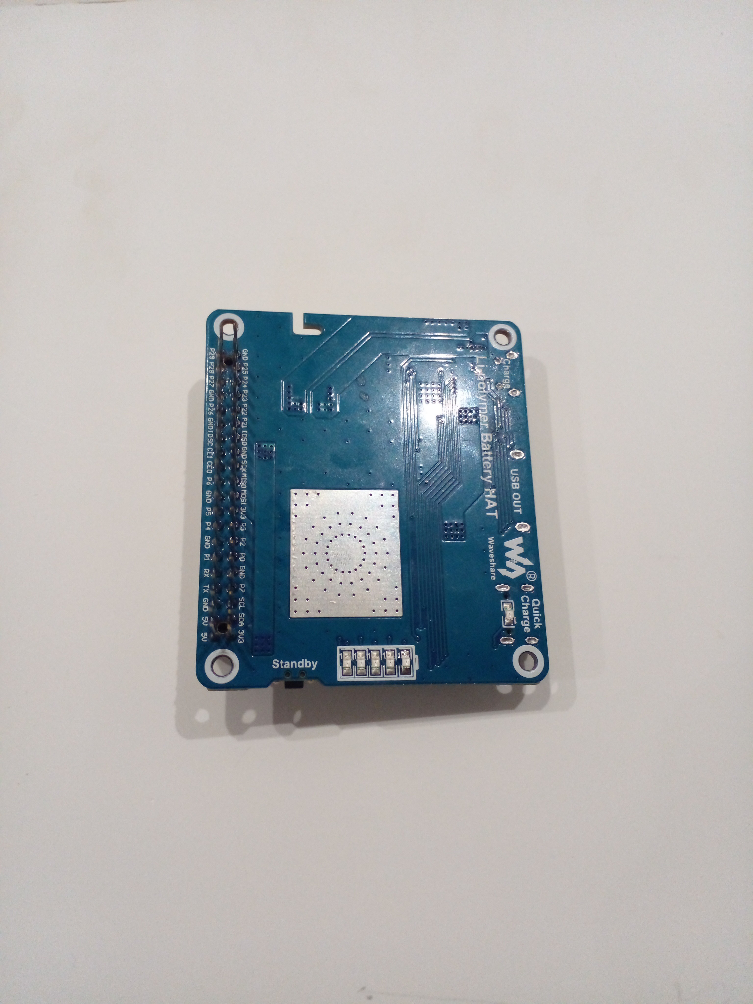
Parts List - SADE Device
Main Board + Cooler $120 The Raspberry Pi 5 provides an easily extendible, well maintained platform with heaps of support and documentation. | Screen $50 The Waveshare 7” Screen is small, portable and very price competitive.
Audio $20 https://www.waveshare.com/wiki/WM8960_Audio_HAT The Waveshare WM8960 Audio Hat allows small laptop speakers and microphones to work with the Pi. | Battery $20 https://www.waveshare.com/wiki/Li-ion_Battery_HAT The Waveshare Li-polymer Battery Hat allows any 3.7V battery to work with the device and it easily clips onto the Pi using the GPIO pins without any hassle.
The 3D printing will cost : $..., Therefore the final cost would be : $210 + $00 = $...
$120 + $50 + $20 + $20 = $210

Slide 39
Production Flowchart One-off Production
Sequence | Equipment | Quality Control
Designing model | CAD Software, A computer | Visual check of design. Ensure all measurement in software are correct and all constraints are in place.
Printing | A 3D Printer, 3D Printer Slicer, A computer | Measure all the sides of the print to the nearest mm.
Polishing | Sandpaper | Touch check of the roughness of the resulting product.
Assemble Electrical Components | Screwdriver, Breadboard Jumpers | Running the device completely disconnected at full brightness.
Input Electrical Components into body | Screwdriver | Softly shake the device for loose parts and inspection of wiring.
Screw in Remaining Panels | Screwdriver | Inspect tightness of screw.
Testing and Evaluation | Completed project tested. | Written evaluation and improvements Suggested.

Slide 40
Model
Now that I have identified the design I will be making, I am going to make a replica / model at a 1 : 1 scale.
The model won’t have any electrical components as the main goal is to test the viability of the ergonomics of the device and its aesthetics.
After completing and testing the model’s dimensions and ergonomics, I will finish the manufacture of the final product.

Slide 41
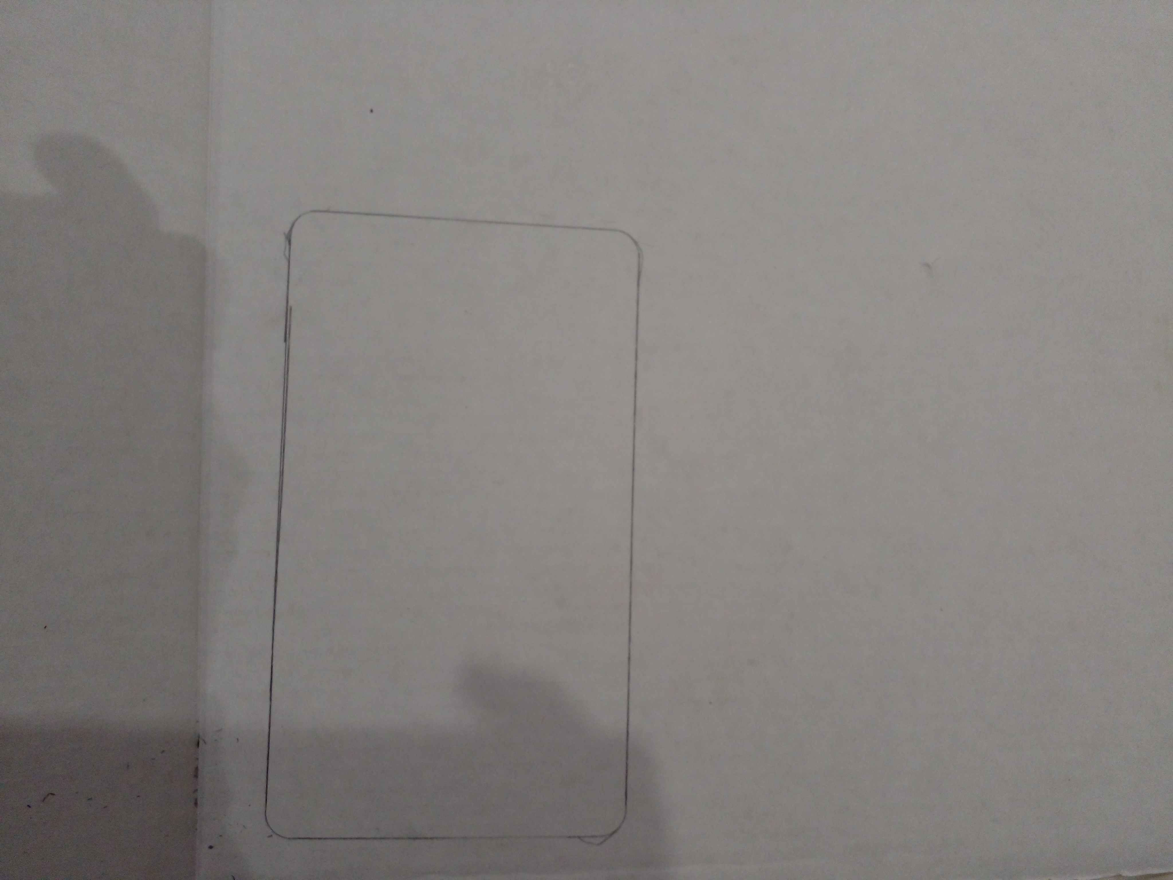
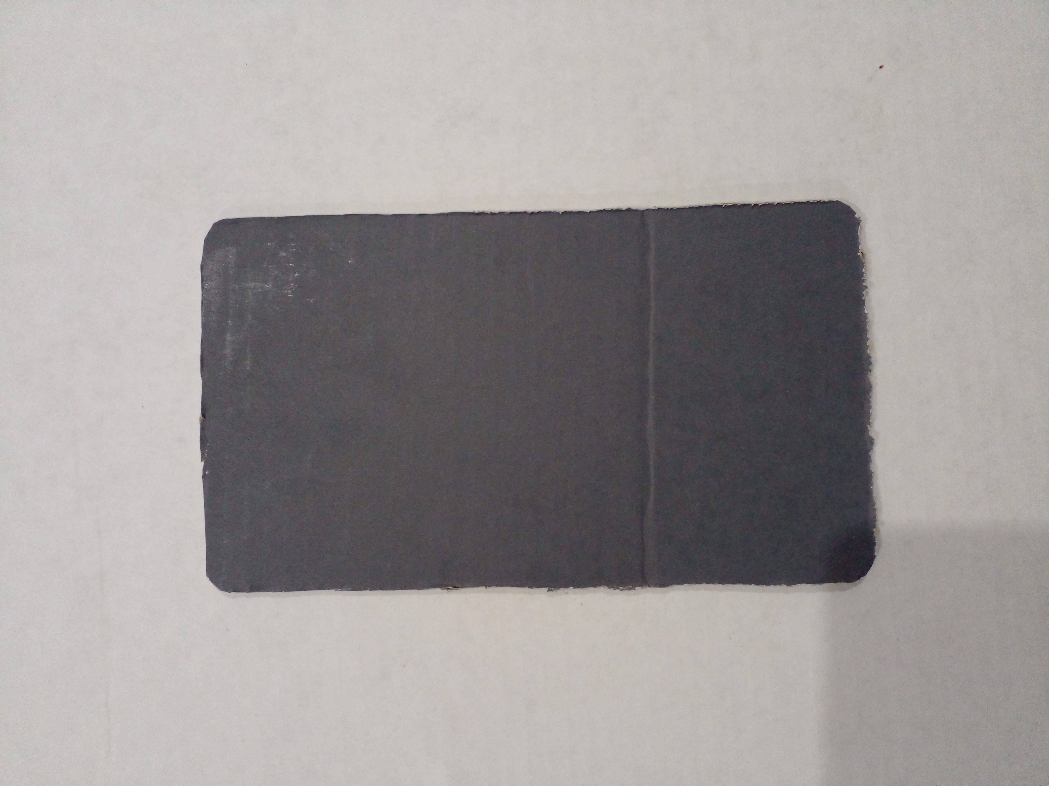
Step 1
Step 2
I first marked out the size of the screen at a 1 : 1 scale using a pencil on two pieces cardboard.
Both pieces of cardboard were then cut out using a craft knife and scissors.

Slide 42
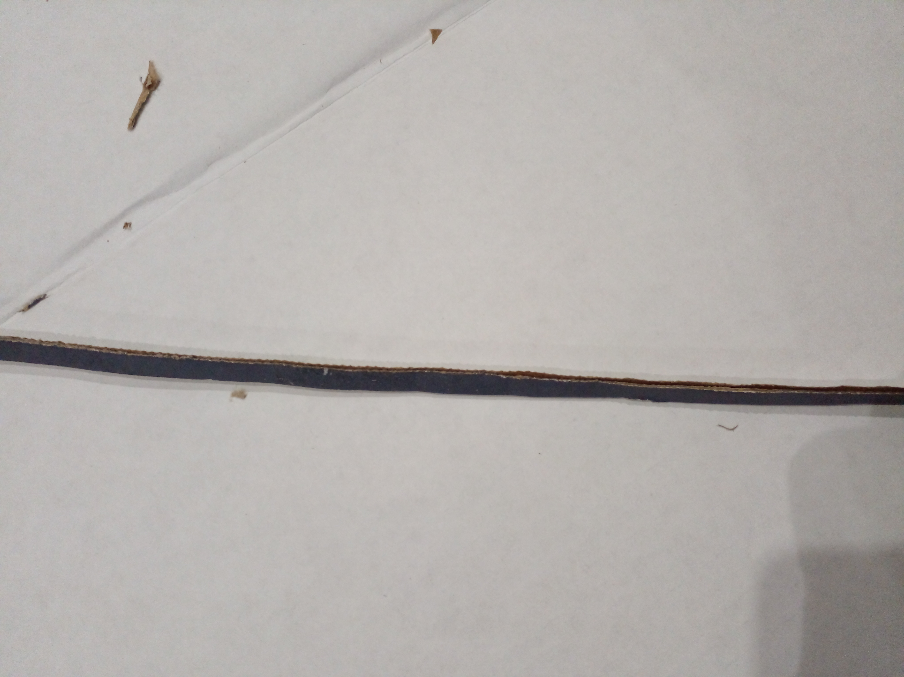
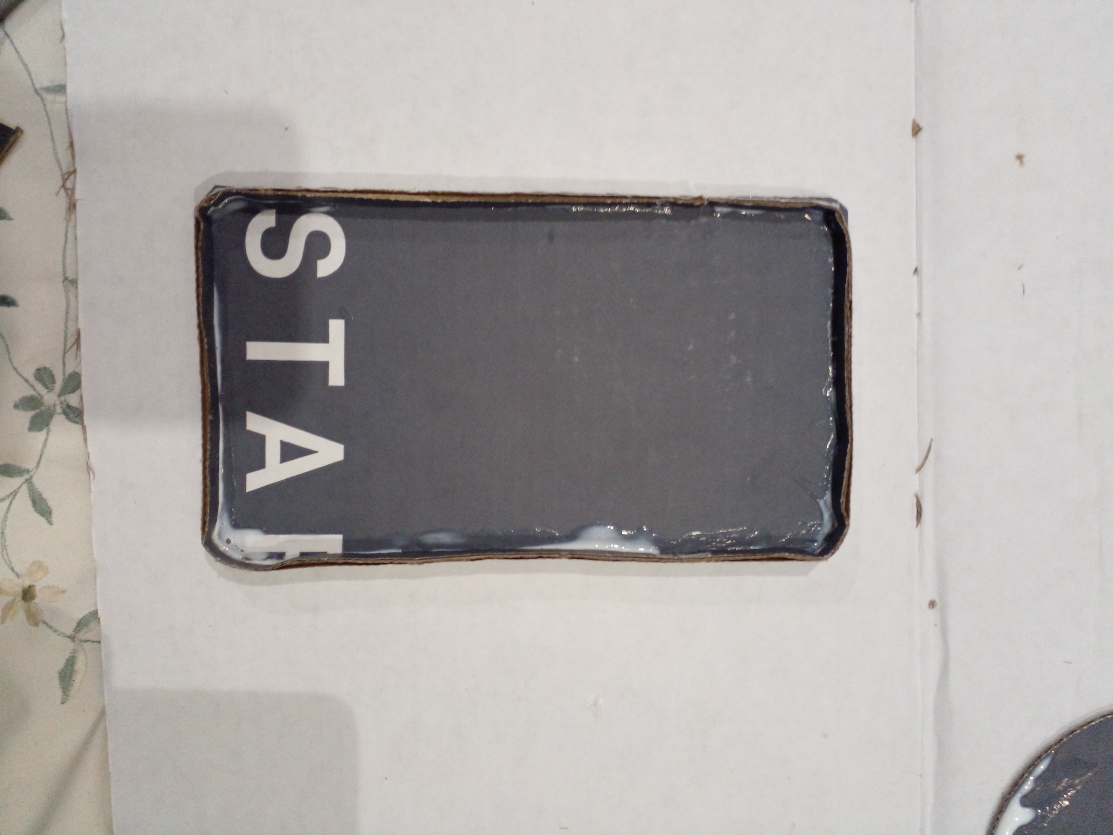
Step 3
Step 4
A long strip of cardboard 80 mm in width was cut out.
The strip was then glued on its side to one of the cardboard faces that were cut out.

Slide 43
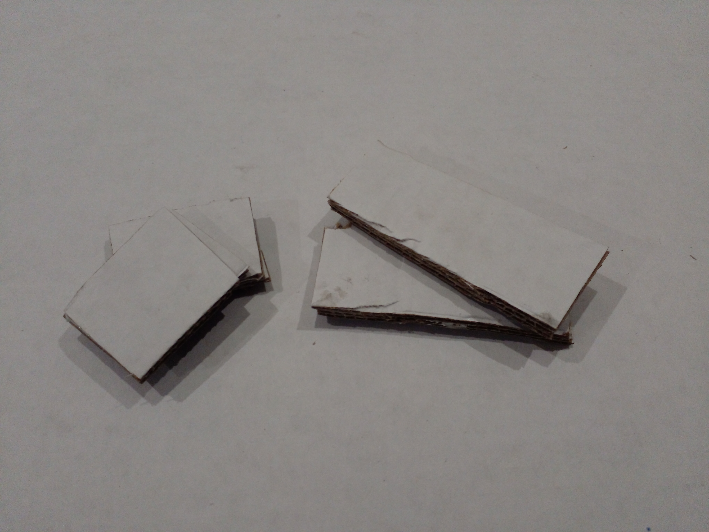
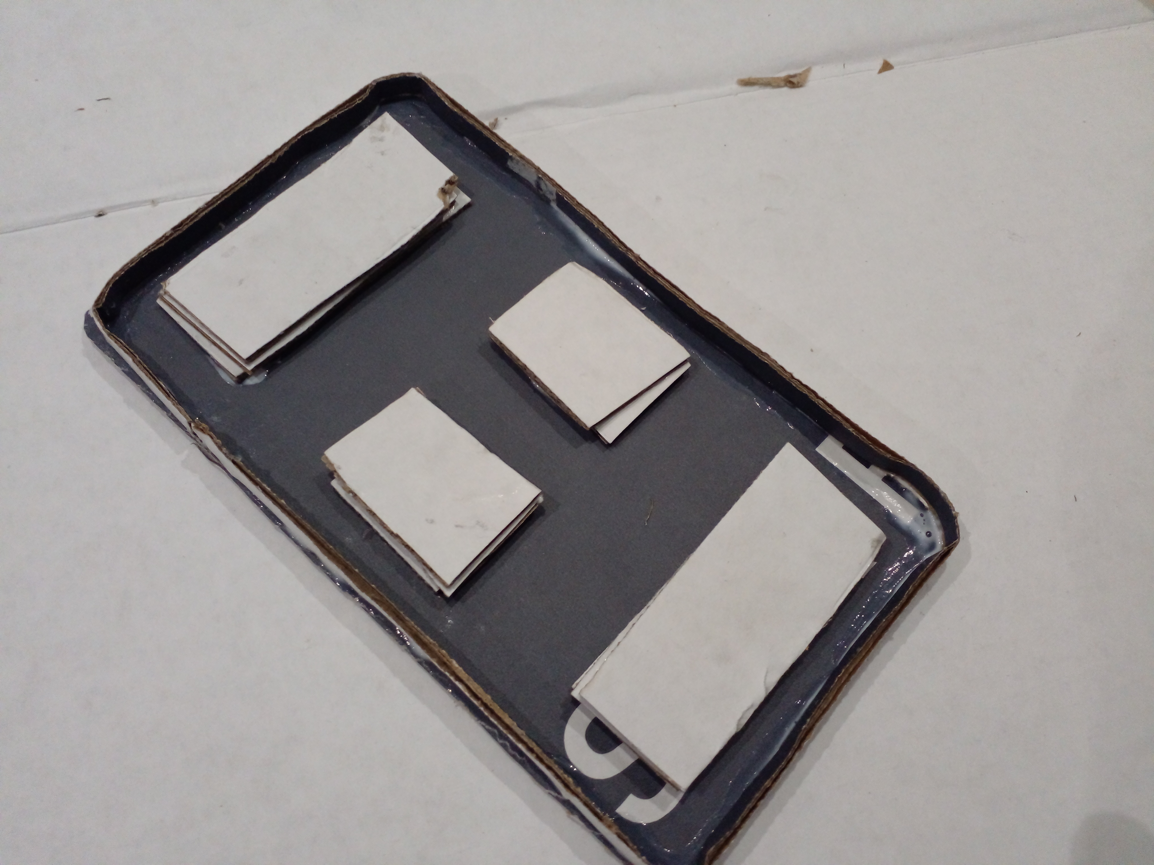
Step 5
Step 6
12 square pieces pf cardboard were measured and cut out and then glued to each other in threes to make 4 supports
The supports were then glued in a pattern that replicates the weighting of the actual panel. The supports also ensures that the structure is strong & stable.

Slide 44
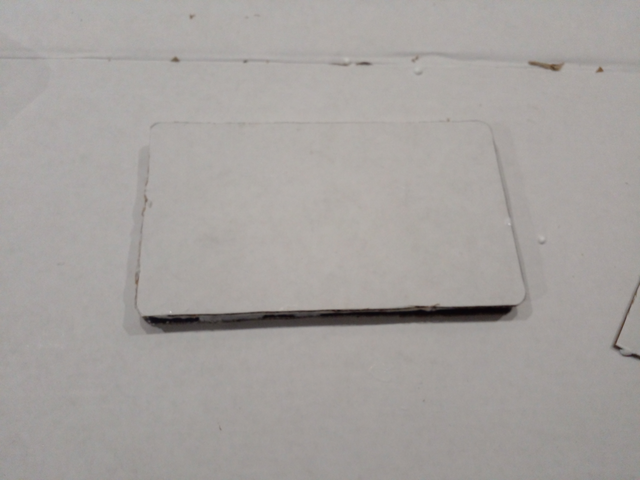
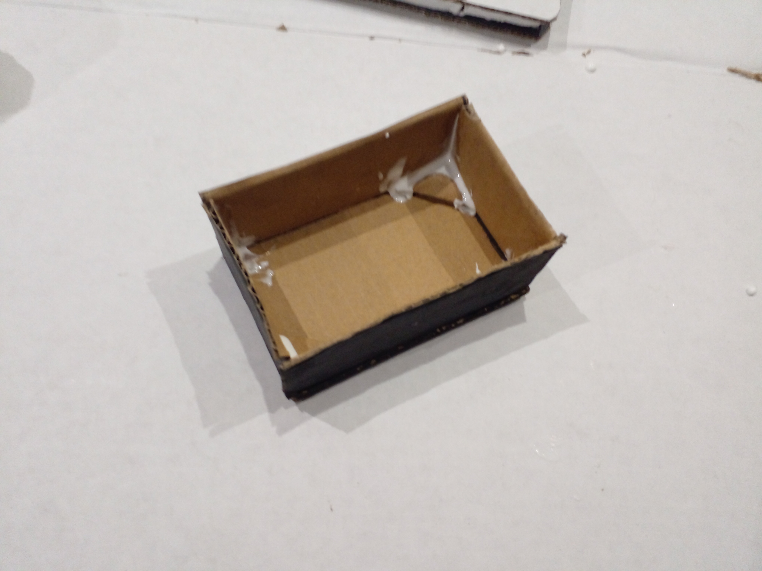
Step 7
Step 8
The last carbdboard face was then glued on top finally completing the screen enclosure.
A new cardboard cuboid was then created by gluing 5 pieces of cardboard together.

Slide 45
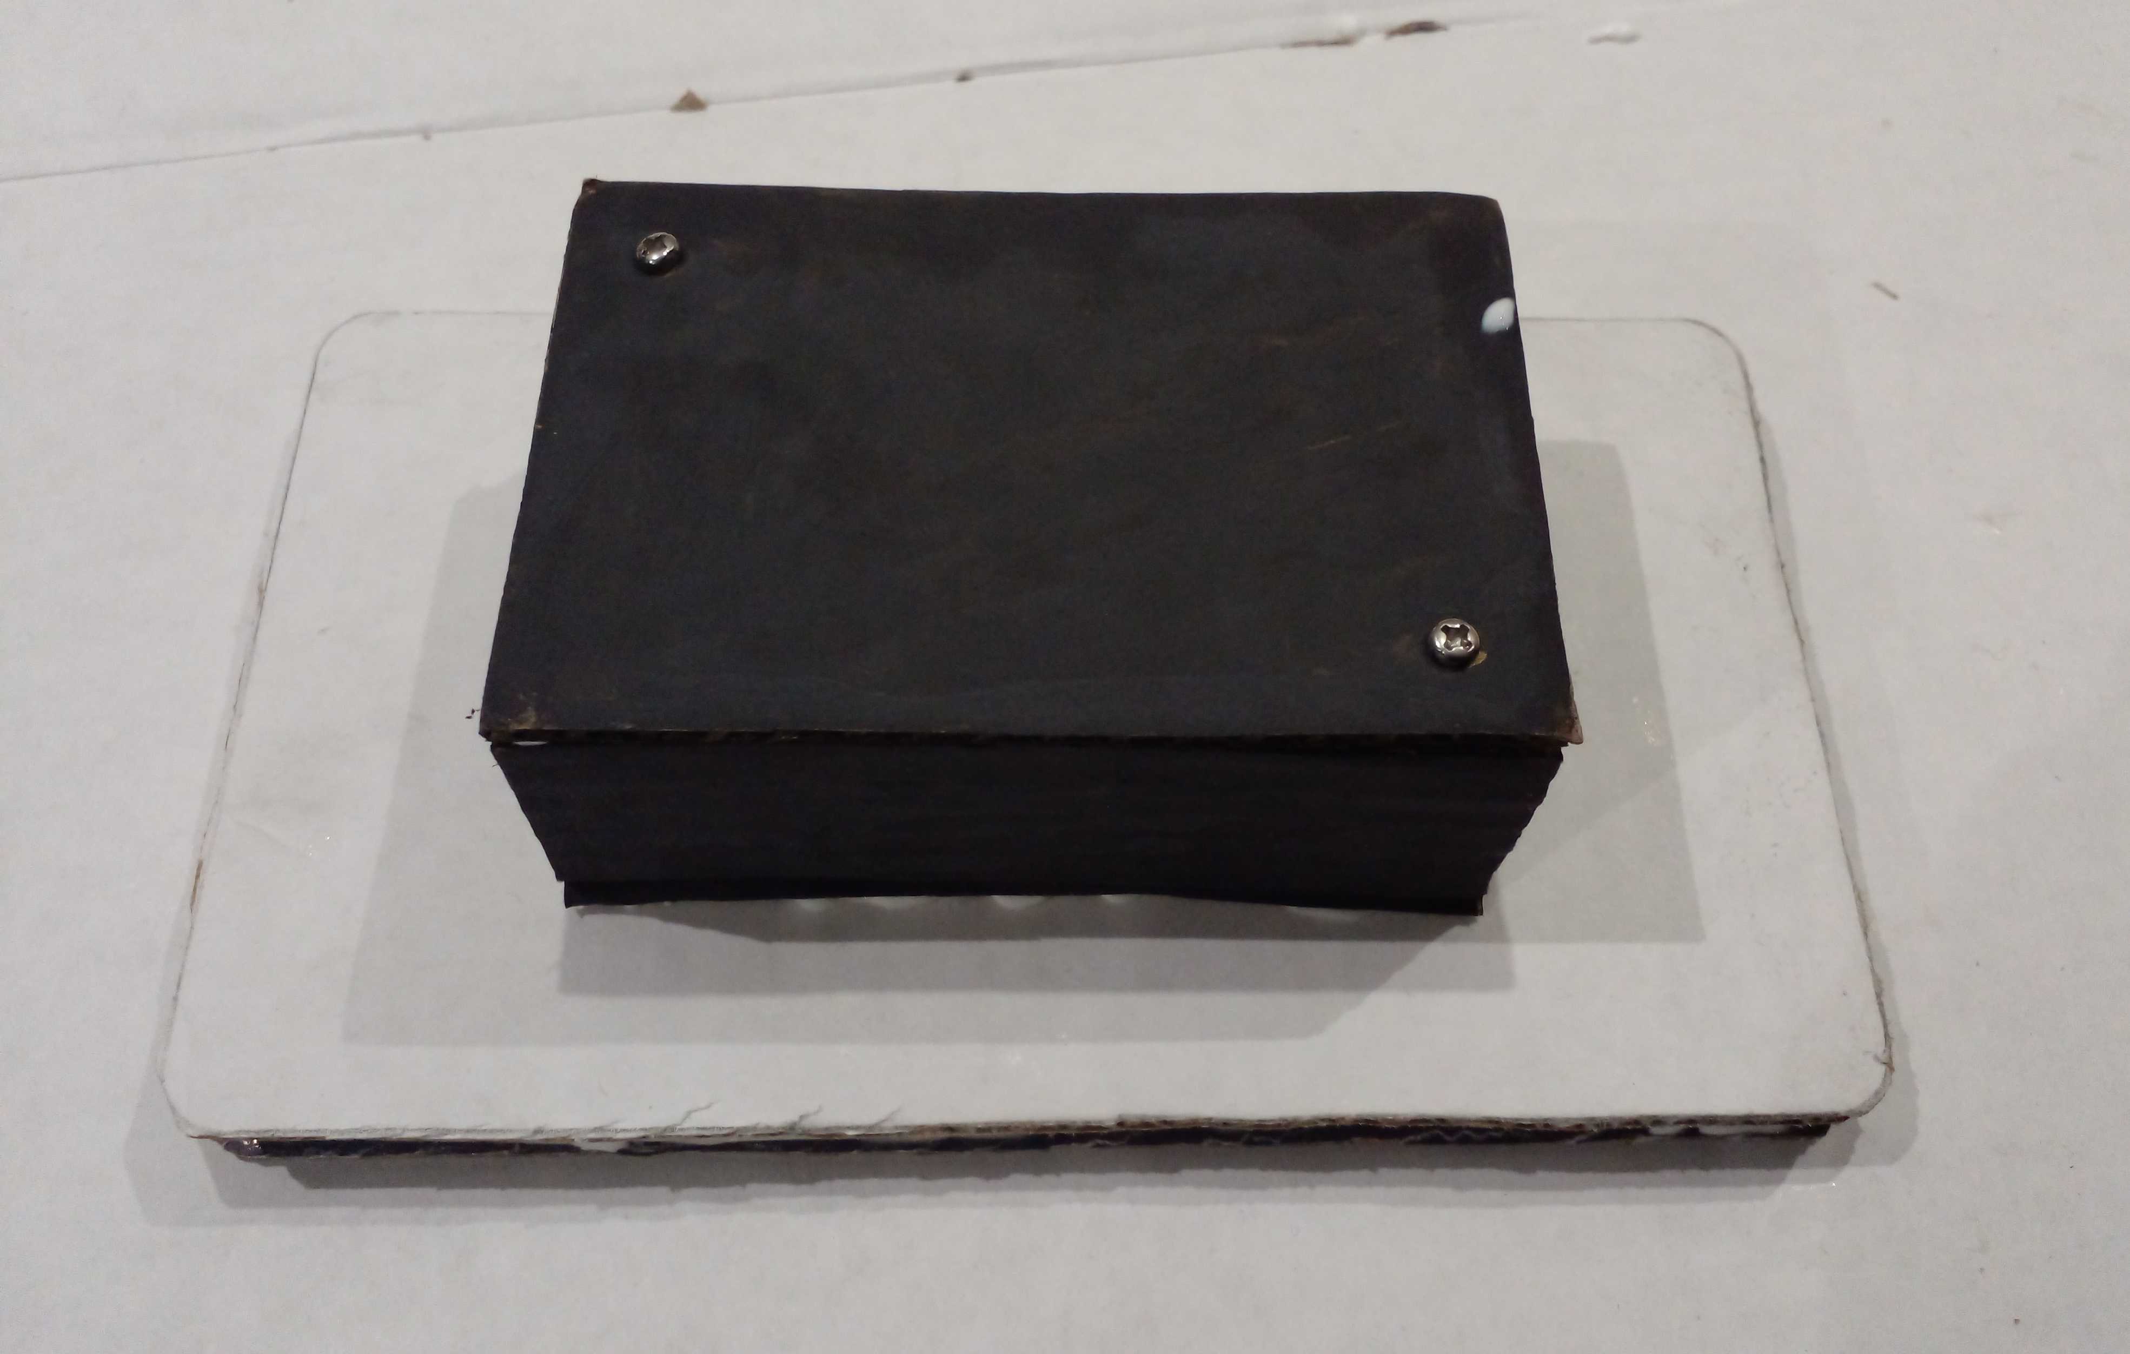
Step 9
Step 10
Both boxes were the glued together to create the final structure of the model.
The boxes were then painted and an image of the raspberry pi display was painted on.

Slide 46
Model Evaluation
The model ended up being slightly too large due to the thickness of the cardboard.
The paint that was used for the project was rough and also didn’t provide and even coat, so a new alternative would need to be found.
The edge at the back of the screen tends to uncomfortably dig into people’s hands.

